Slide 1
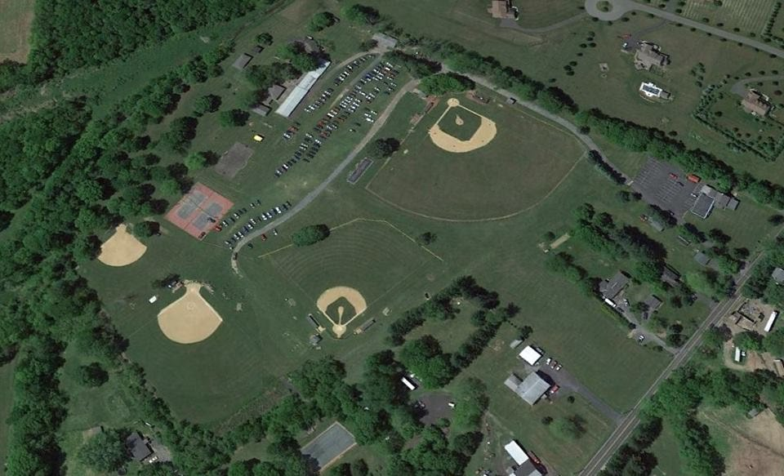

Silver Creek
Athletic Association
A Look Back and A Look Ahead…
Springtown, PA

Slide 2
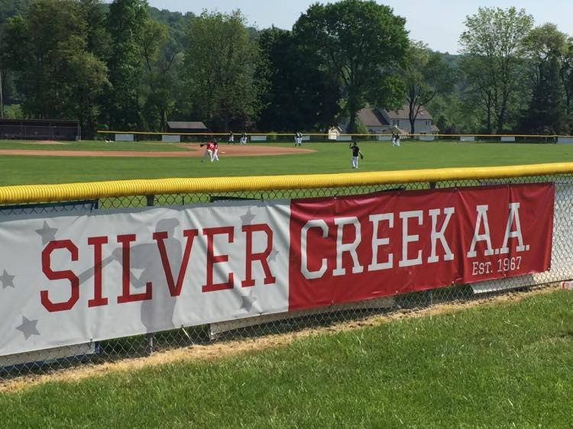
Our Mission
Silver Creek: They can’t take it out of you, and they can’t put it into you.
This place has a lot in common with Roosevelt’s New Deal alphabet soup recipe for economic recovery. We often compare it to a Works Progress Administration (WPA) project.
SCAA is a multi-generational organization that was founded over 50 years ago to establish, promote and maintain baseball and softball opportunities for the children of Springfield Township and the Upper Bucks County Region of Pennsylvania. Our efforts have spanned not only decades, but also the lives of area athletes, their families support and many changes in society. Fair Competition, Sportsmanship and Fellowship are the foundation of our mission and these ideals never go out of style. ​

Slide 3
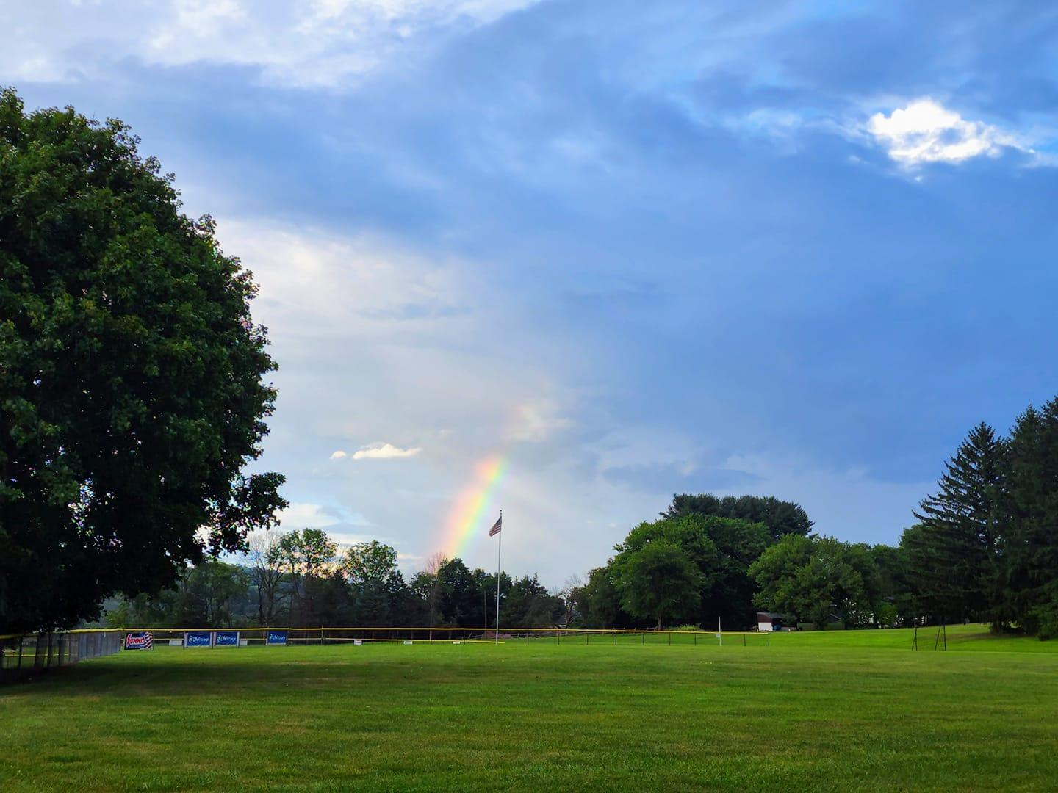
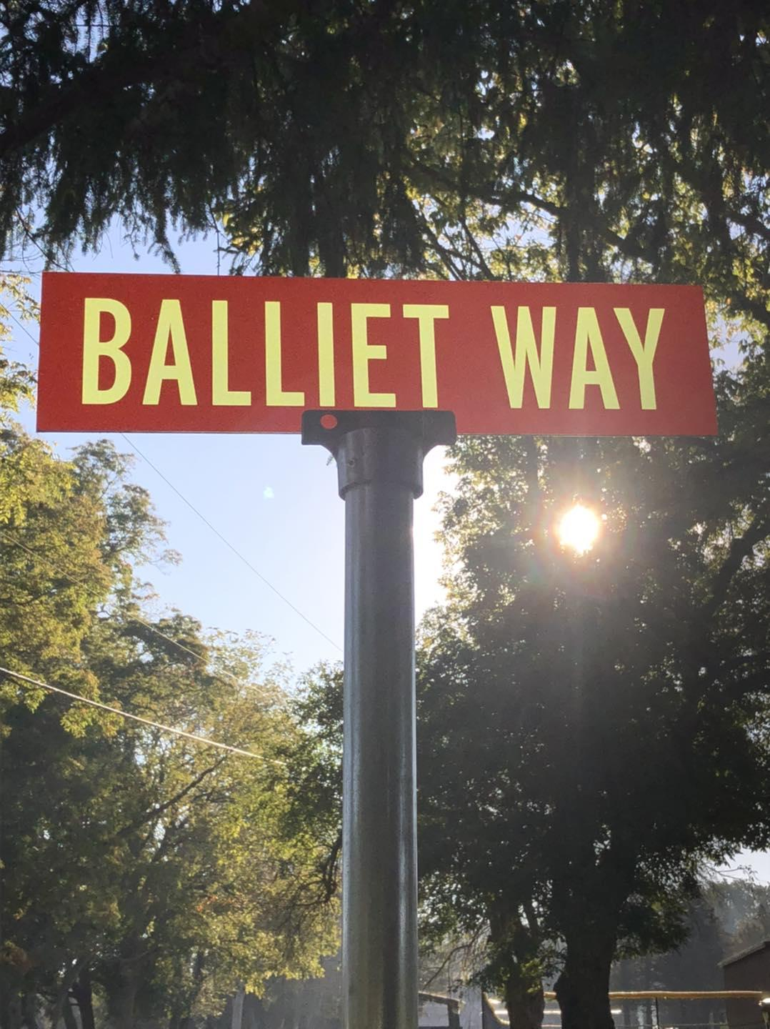
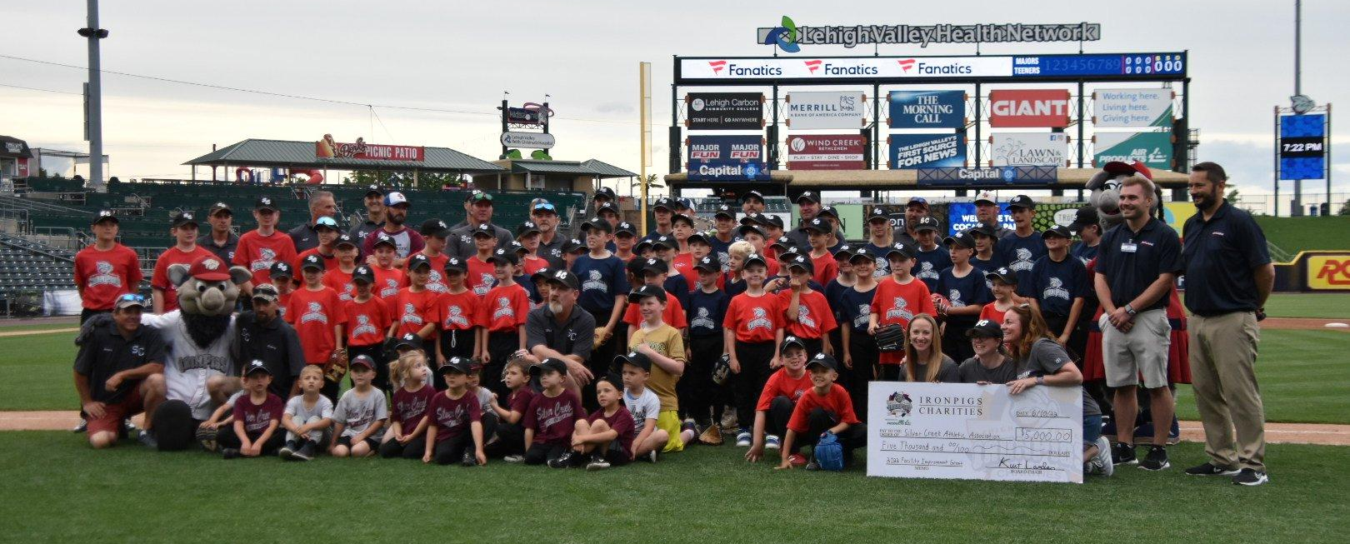

Slide 4
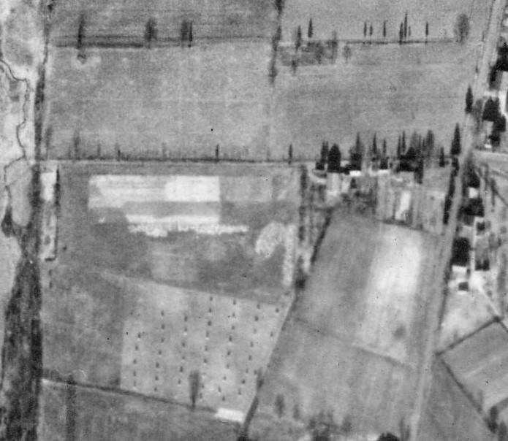
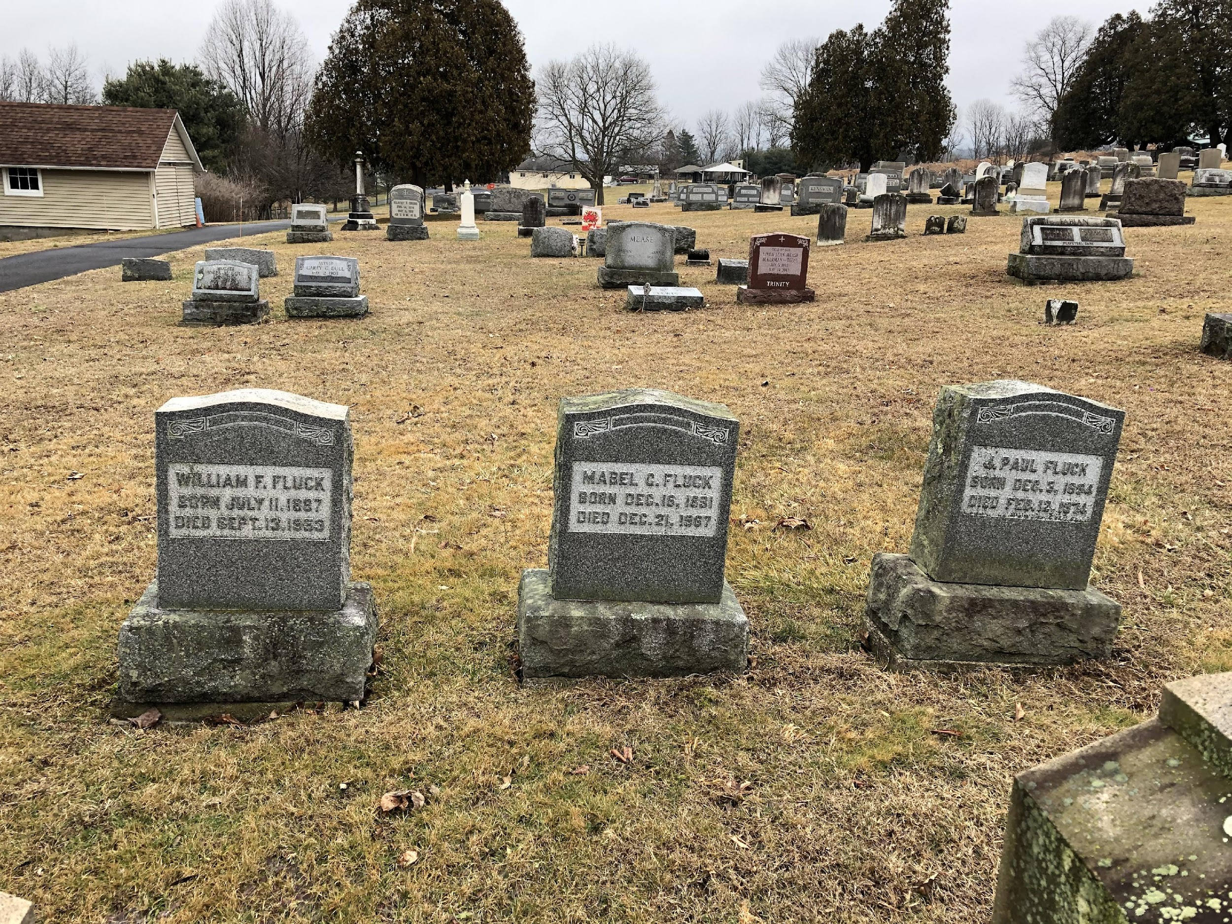
Fluck’s Farm January 9, 1938
Not Just a Vegetable Farm…
And, Any Plot of Land can be developed into something amazing.
Fluck’s Farm in Springtown, PA​

Slide 5
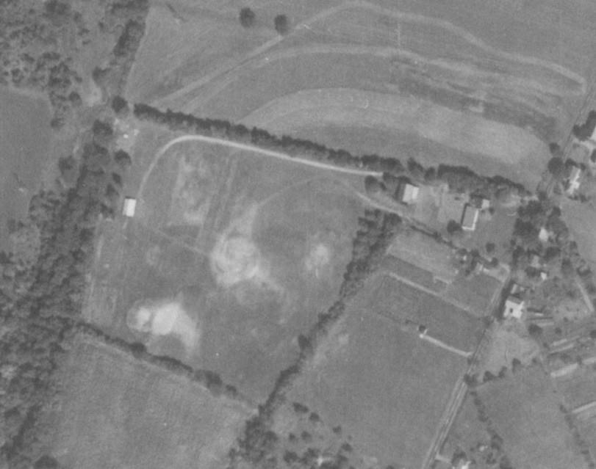


September 23, 1958
Just Before It All Happened
Community Pavilion and access road are visible, property has been cleared and many of the current trees have not been planted.

Slide 6
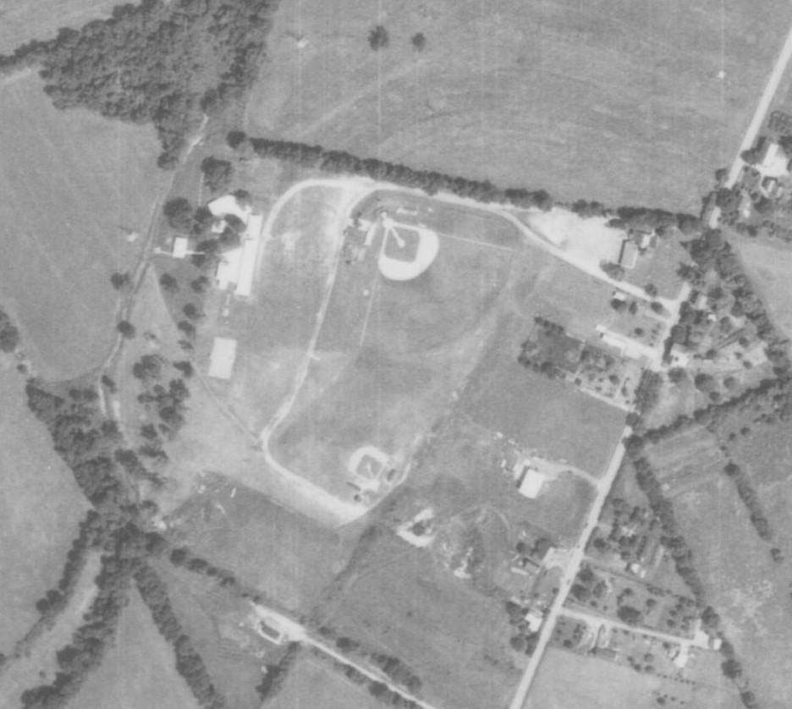
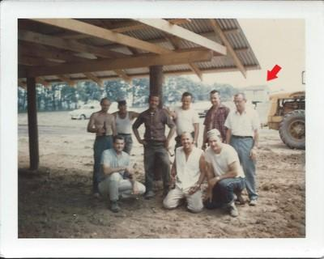
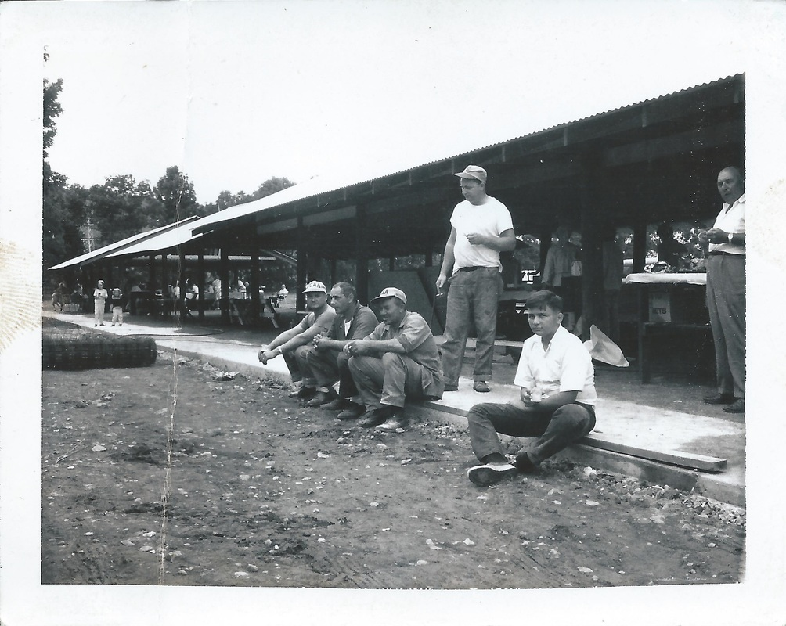
August 6, 1971
Establishing Direction and a Model for Success
If you’re seeing it at Silver Creek, it means that a volunteer conceived it, designed it, built it and that same volunteer may or may not have been back when it needed to be fixed.
Vision and follow through are the most precious of resources that we can have. In fact, it comes right after families on the list of highest priorities.
The formula for the facility to operate was established at the beginning. “A place for us and all of our families…”
Pavilions expanded, Stage, Restrooms, Central Kitchen,SC#1, SC#2, Basketball Court all established and Trees have grown a lot in the 13 years since 1958.​

Slide 7
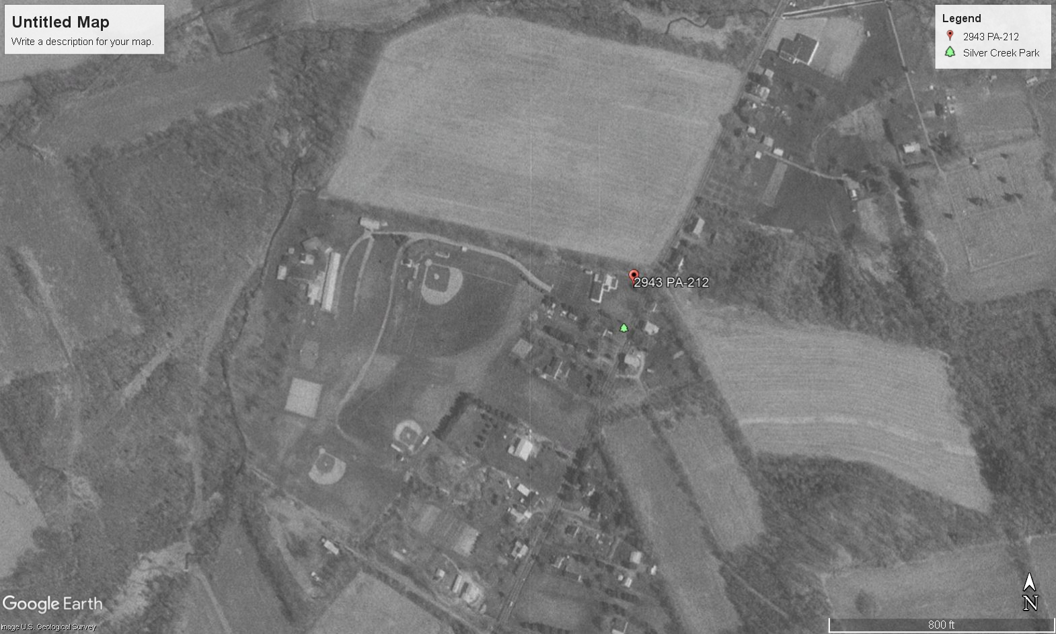
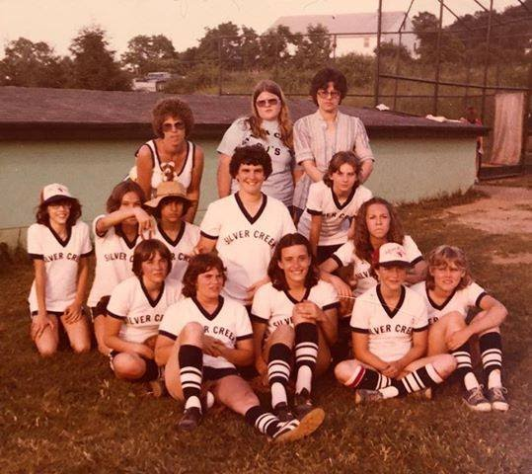
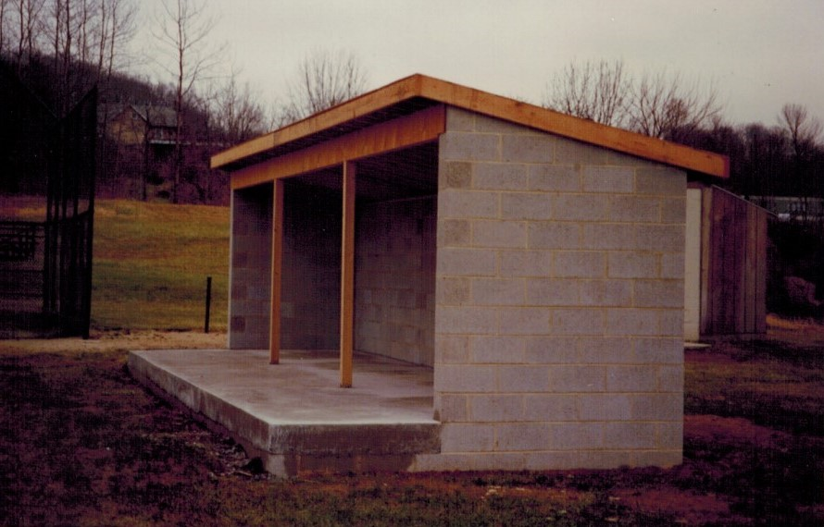
1993
The World Finds Springfield Township
Influx of new families-many from New Jersey and New York. Graduates of area colleges staying in the area is also a factor.
A growing generation who don’t know Silver Creek from growing up in the area are now our customers.
Tennis Court, SC#3 with a Grass Infield and the Garage are visible-Very busy 22 years since 1971.​

Slide 8
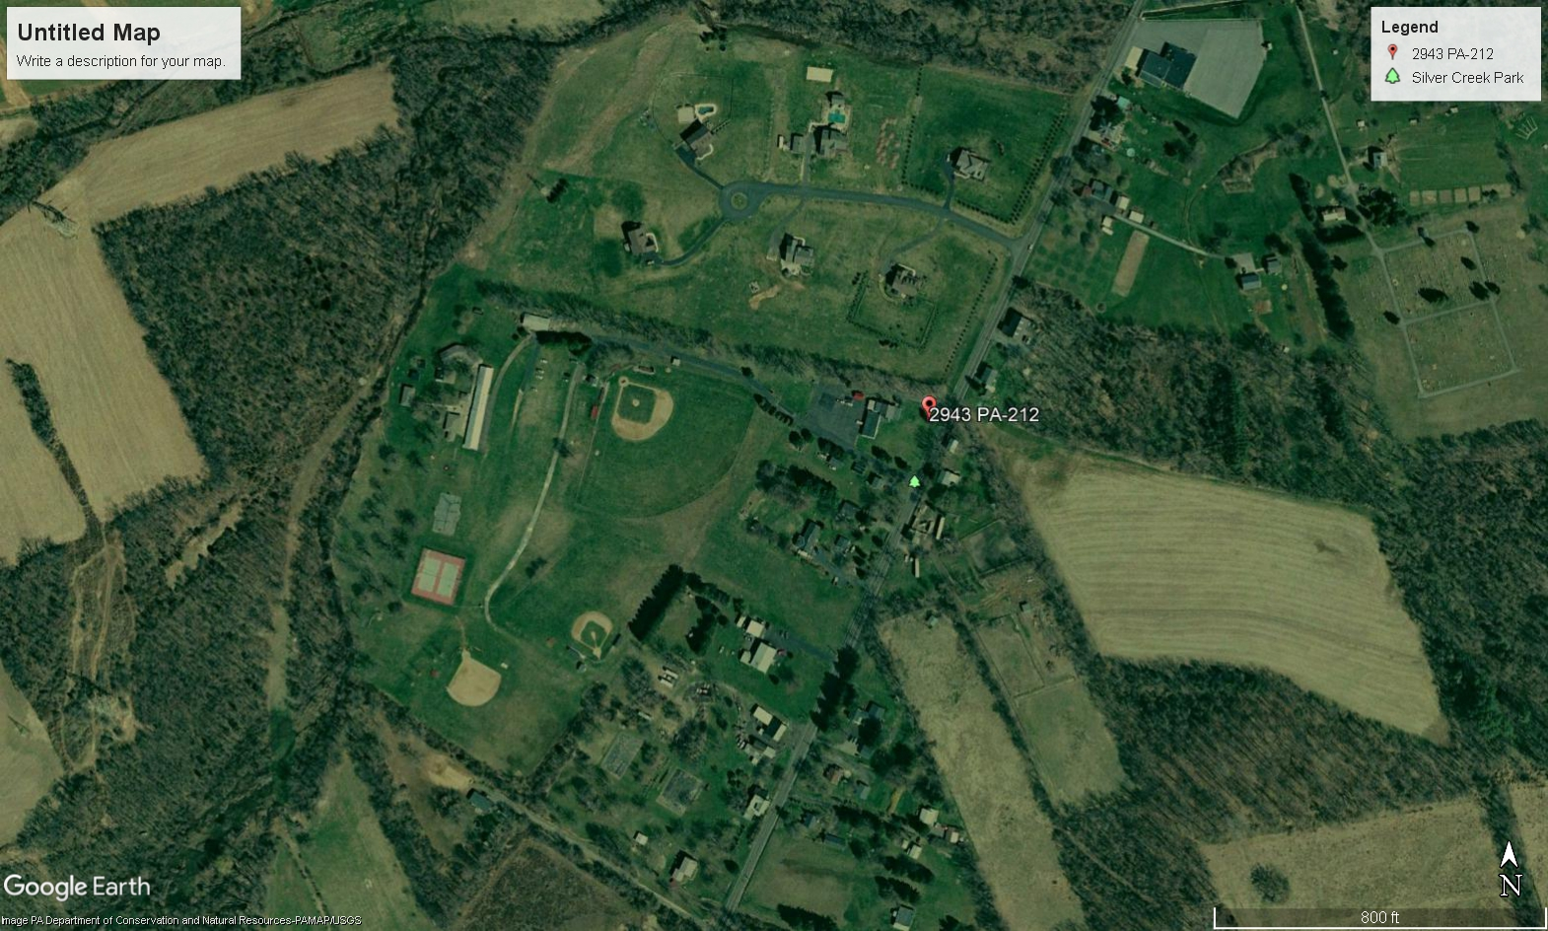
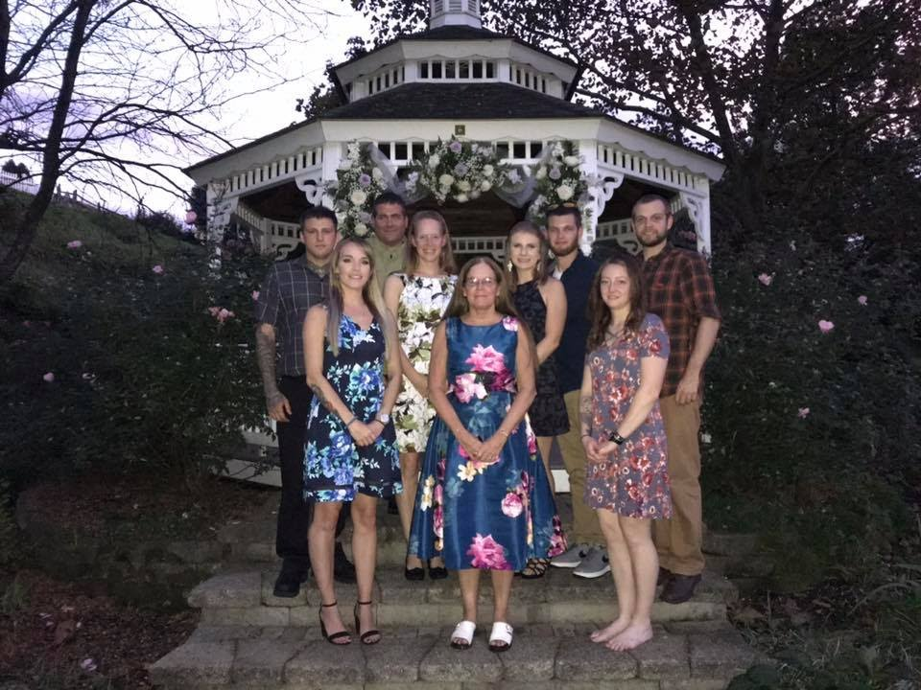
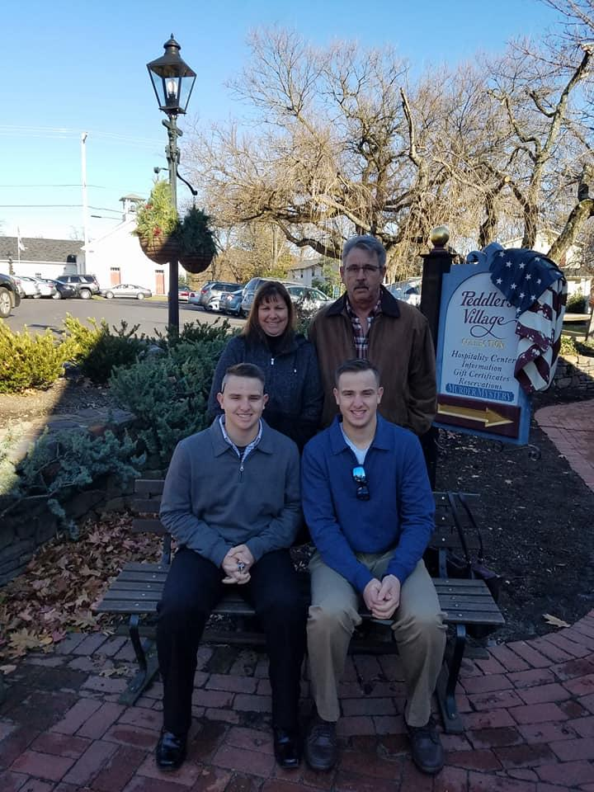
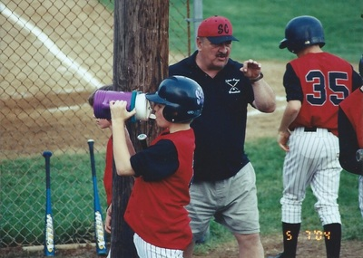
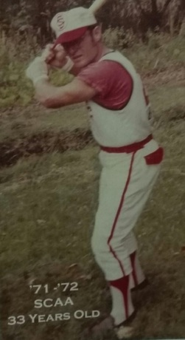
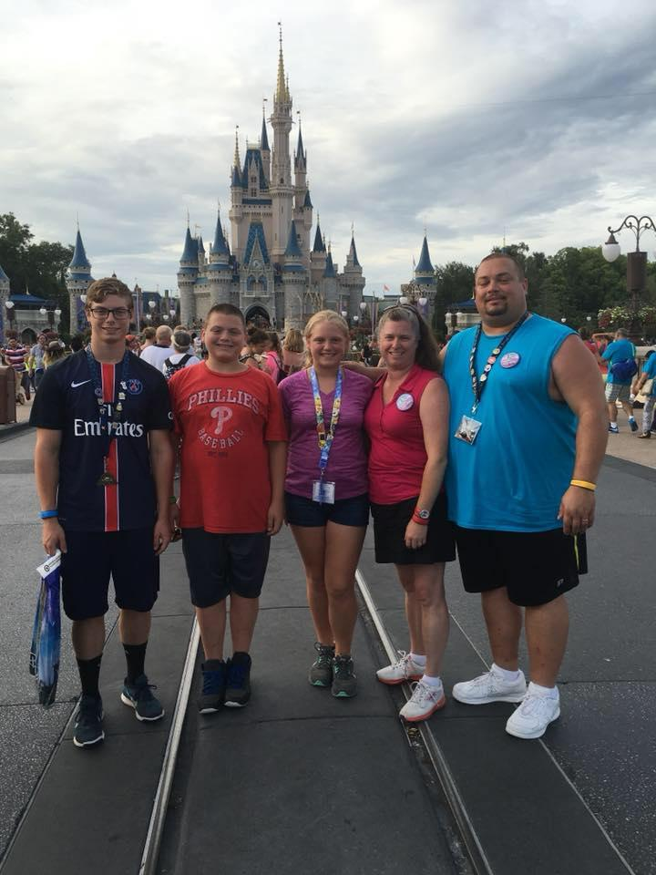
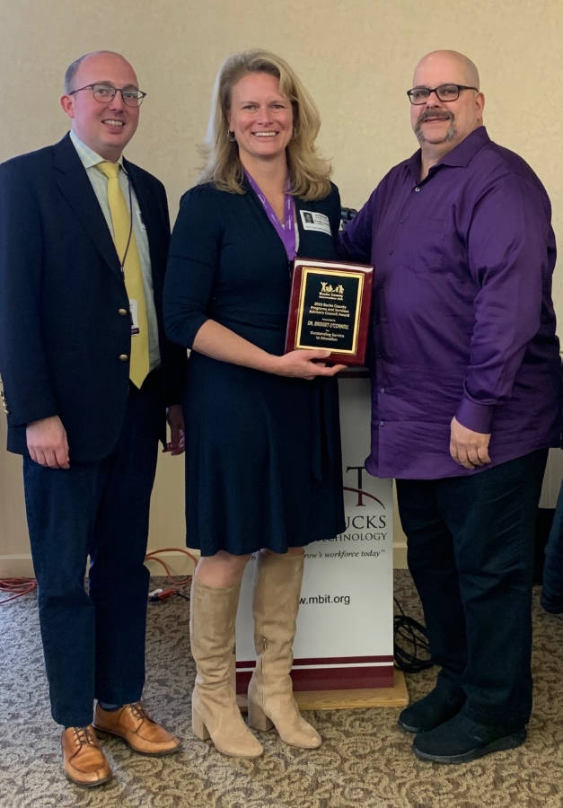
2005
New Faces, Same Responsibilities
Within a few years of 2005, the majority of Silver Creek’s Board are families who did not grow up in the Palisades School District.
Glenn Balliet
born 1939
66 years old in 2005
Coach Kenny Garey

Slide 9
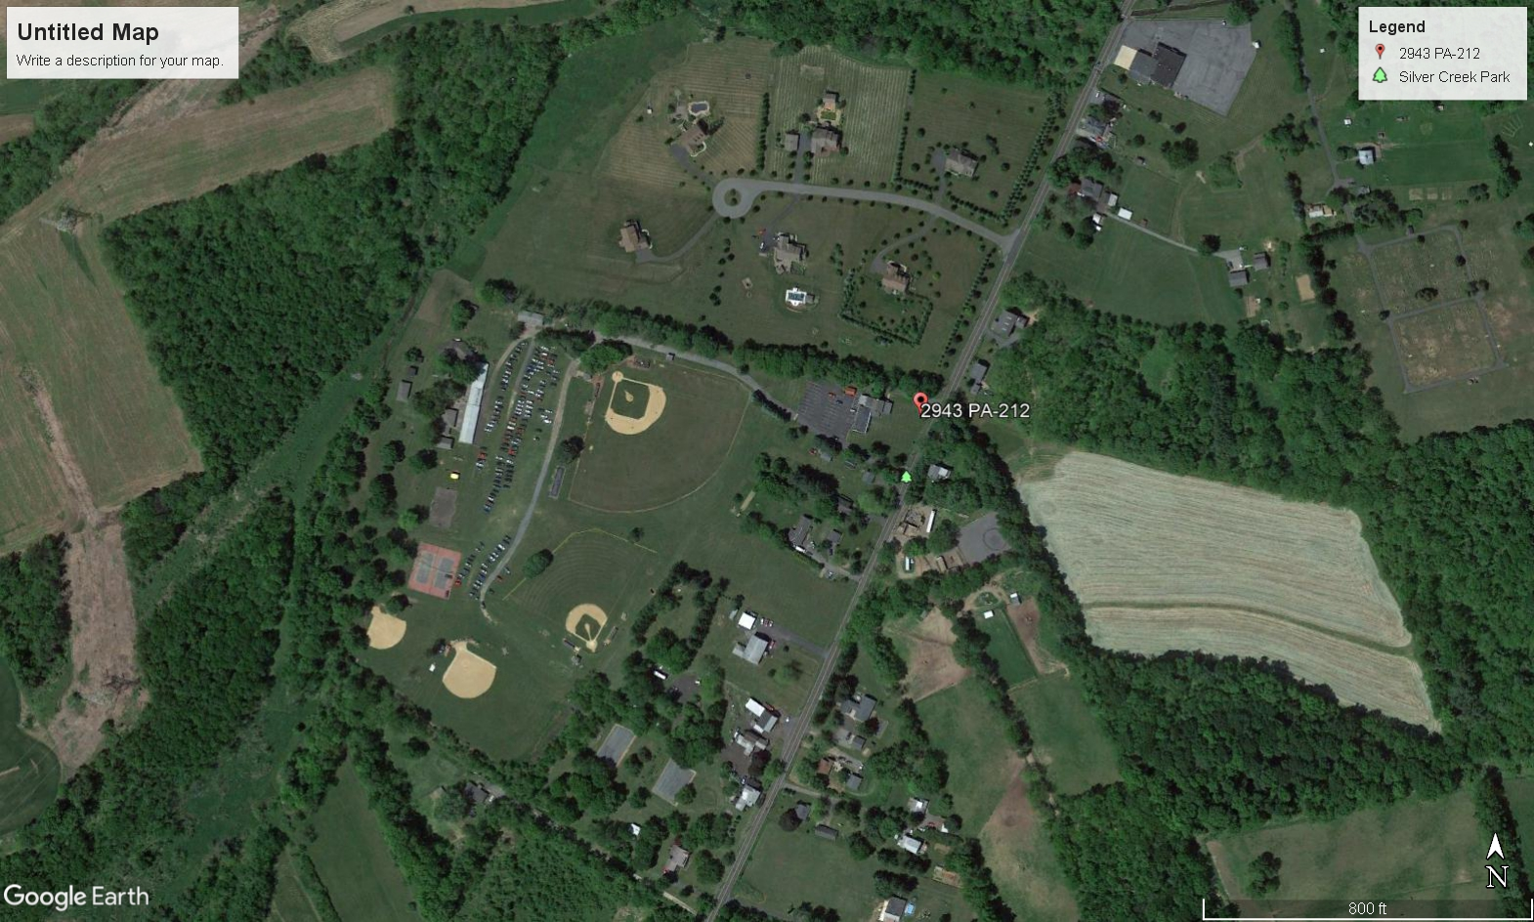
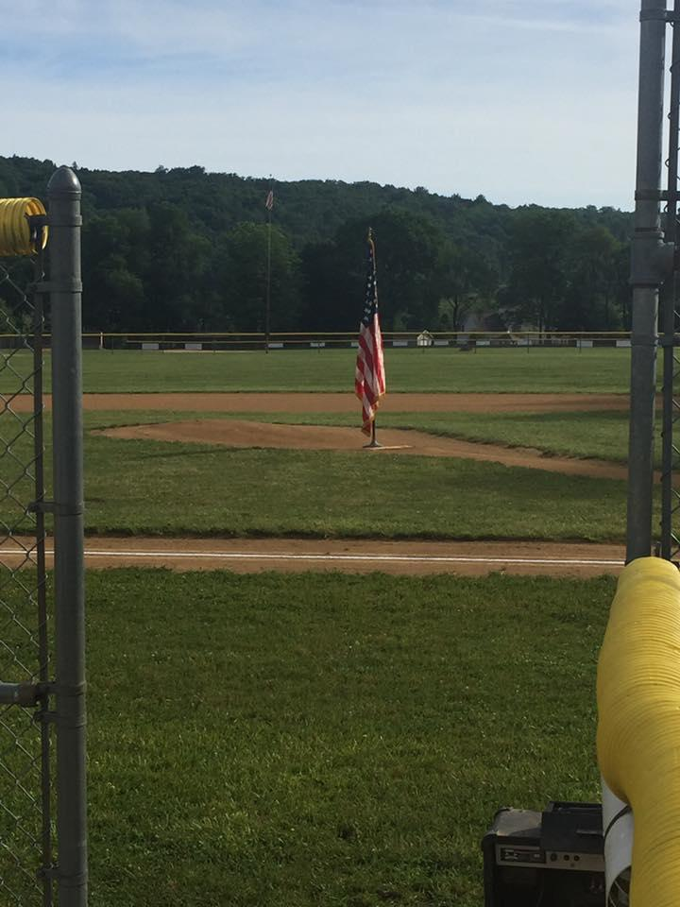
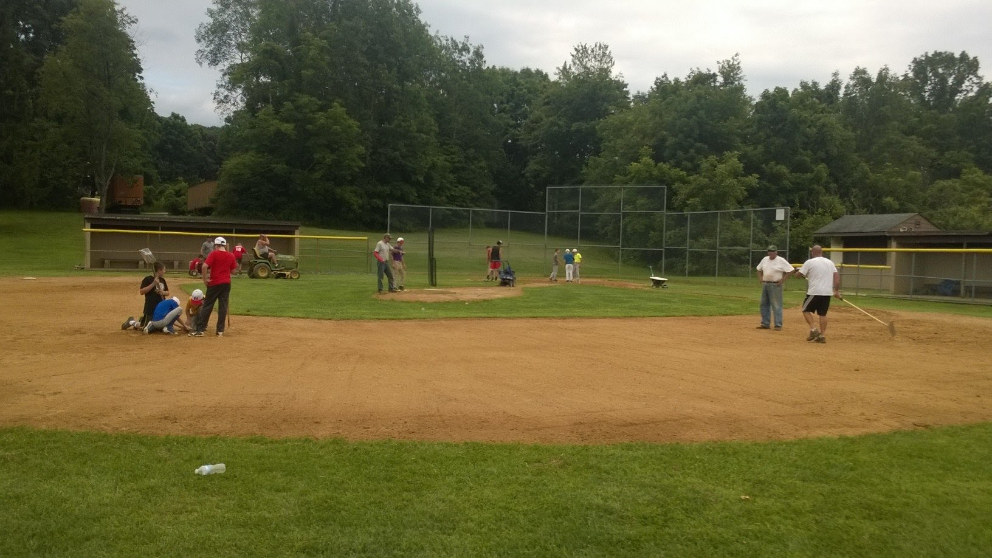

2012
Making Tough Decisions
The last Labor and Memorial Day Picnics happen in 2013.
Penn-Jersey League for 12U baseball has fewer teams each year.
Upper Bucks Softball League reforms into 4 year age brackets.
Pitching Rules regulating the participation of Scholastic Athletes Complicates Rostering for “Teeners.”
Tournament Baseball grows in popularity and availability.
New Pavilion at the End of the Kitchen Portico and SC#4.​

Slide 10
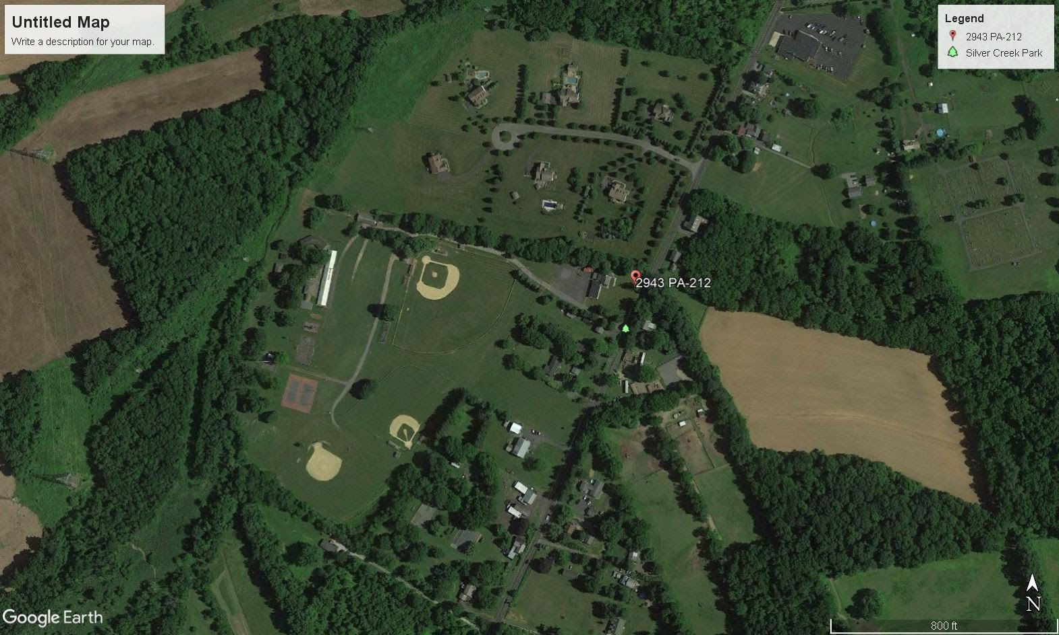
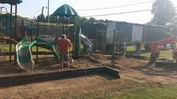
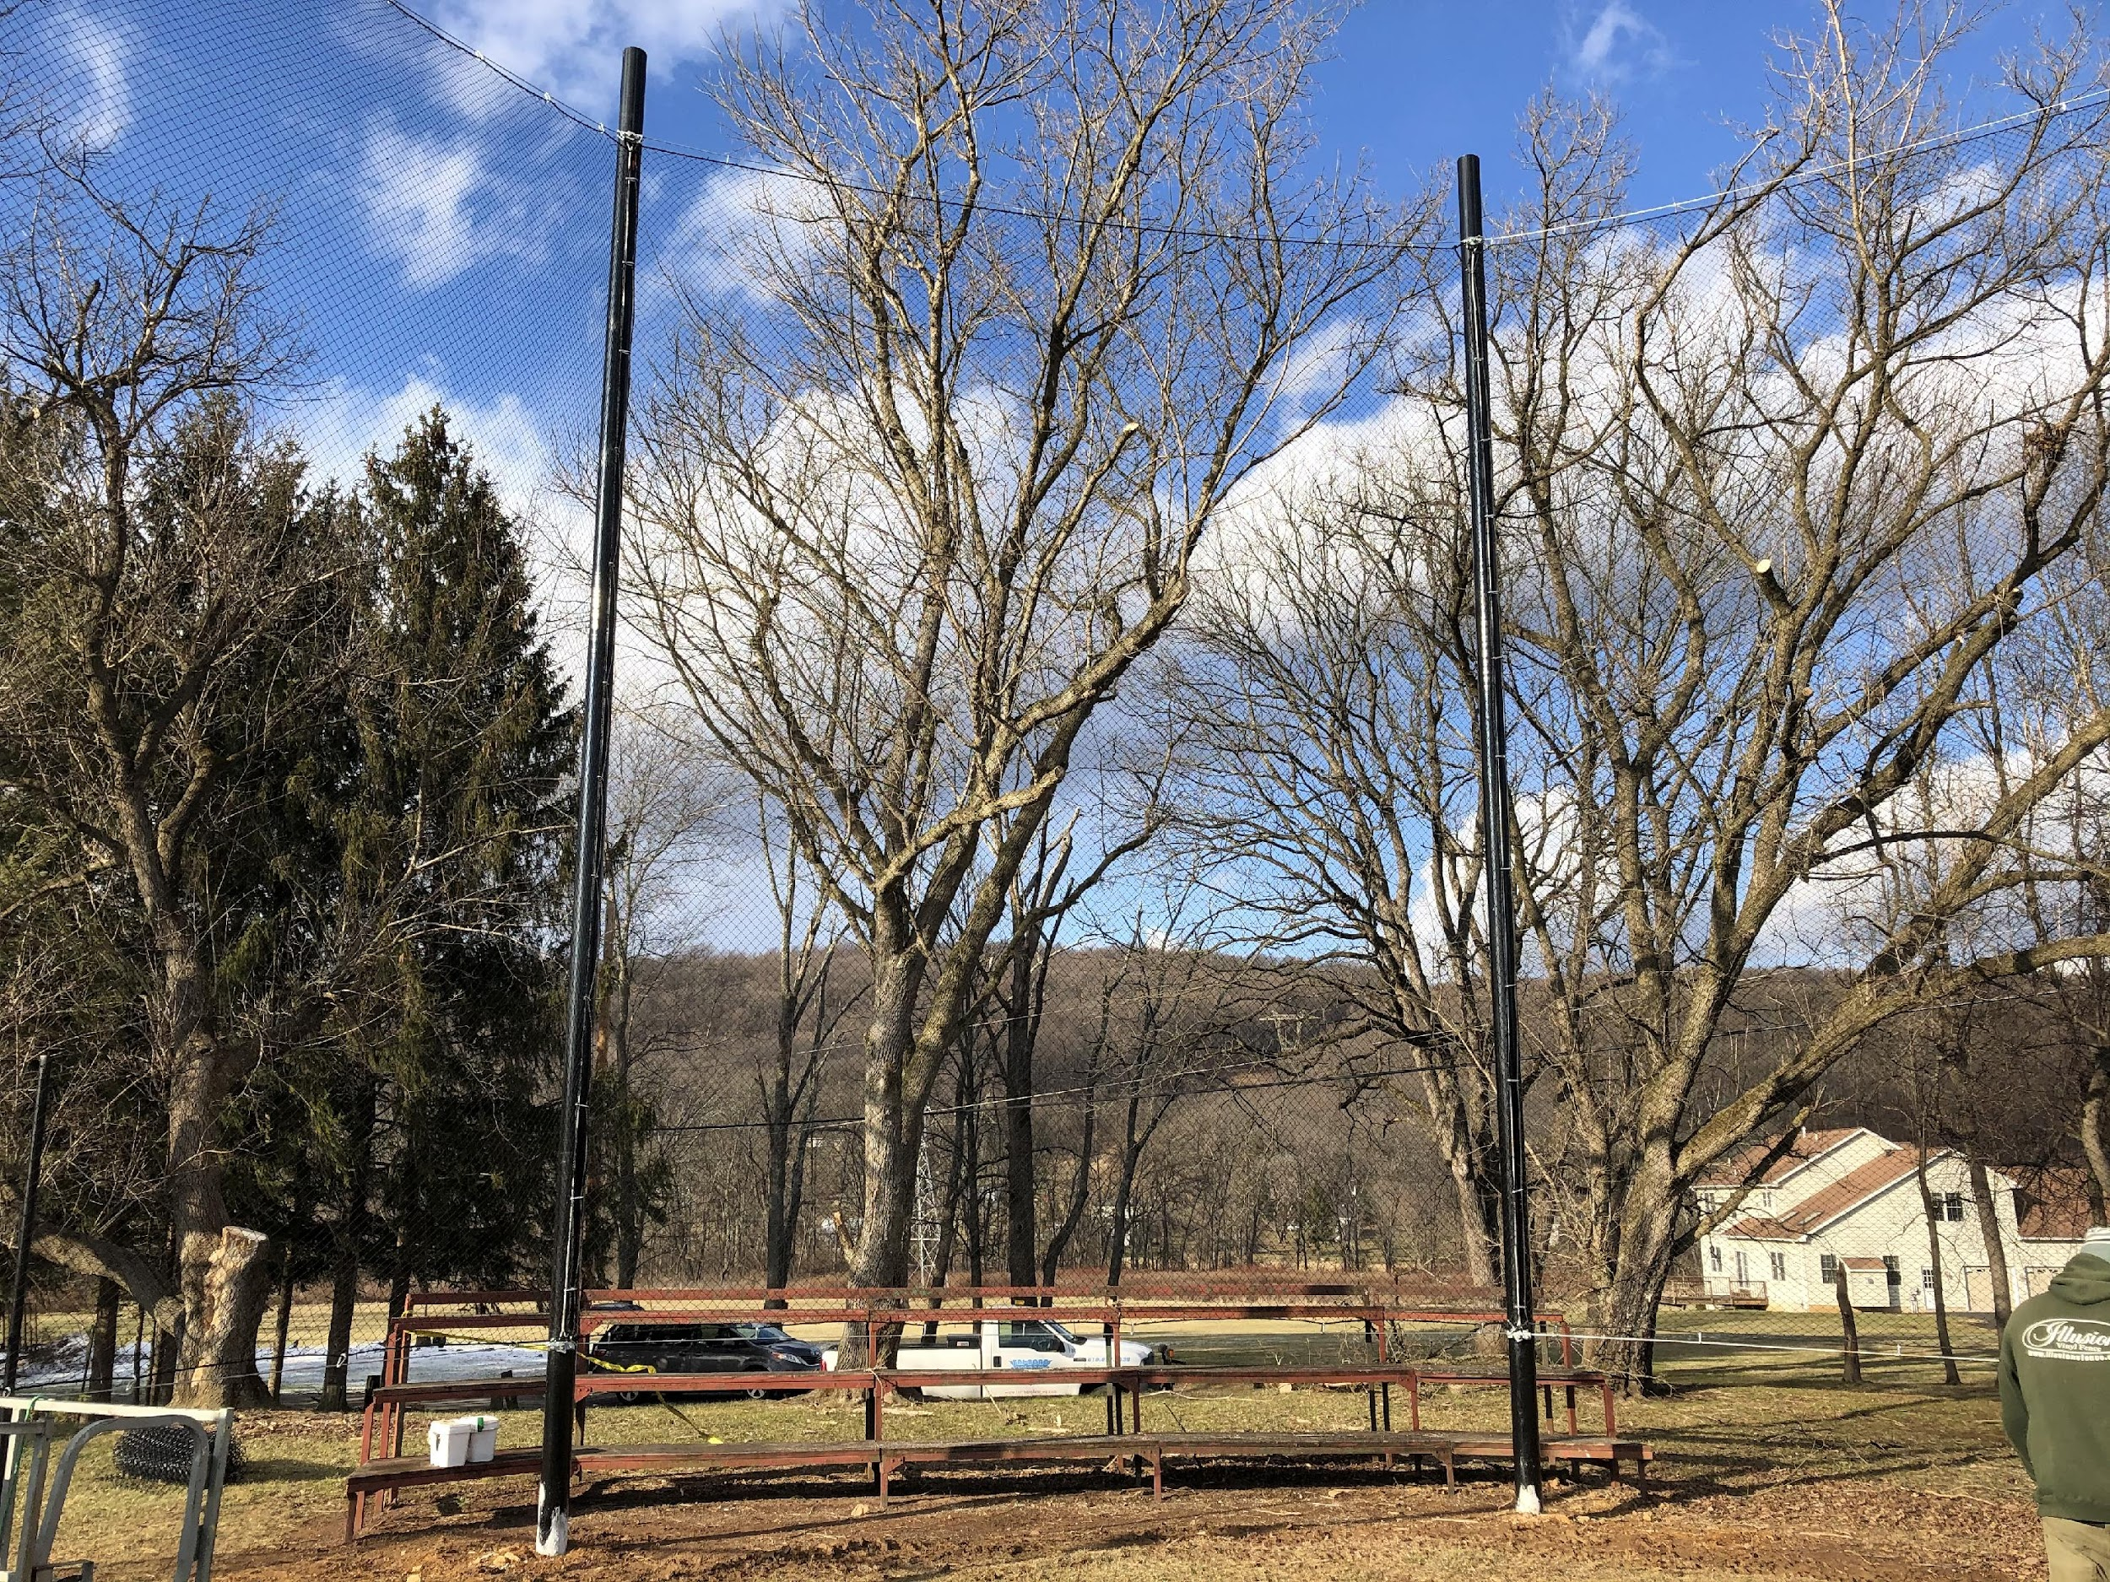
2018
Stability of Leadership, Strategic Planning, Tactical Execution
Fiscal Conservancy, Moving Toward New Fundraisers and increasing Facility Rentals Position Silver Creek A.A. for a Bright Future.
Facility Resources rather than just Team or League.
www.silvercreekathleticassociation.com launches in 2015.
New Playground Summer 2015, Demolition of Outhouses, SC#4 returned to a grass baseline with the prospect of infield mix on the bases, mound and dish

Slide 11
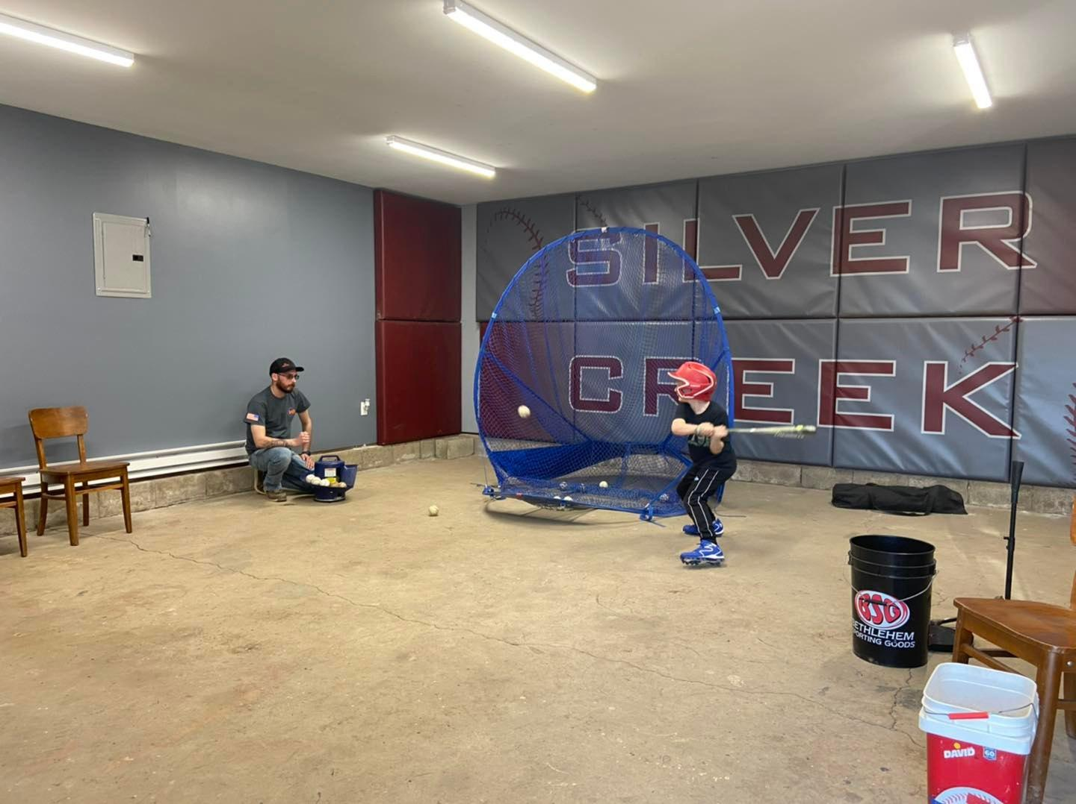
In winter of 2021-2022 our coaches worked hard to create a workout space for our teams.
Seen here, our new training room! Perfect for off-season workouts and batting practice!

Slide 12
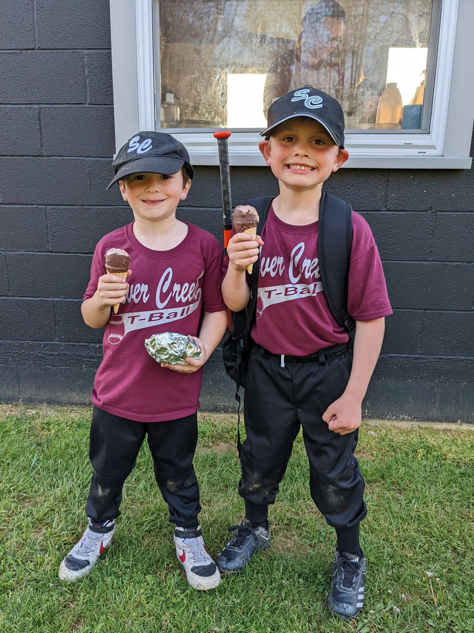
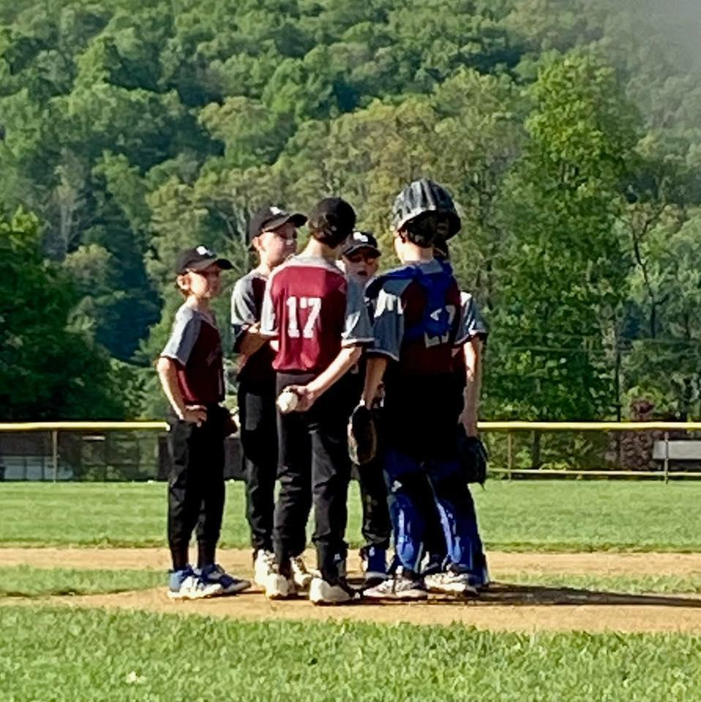
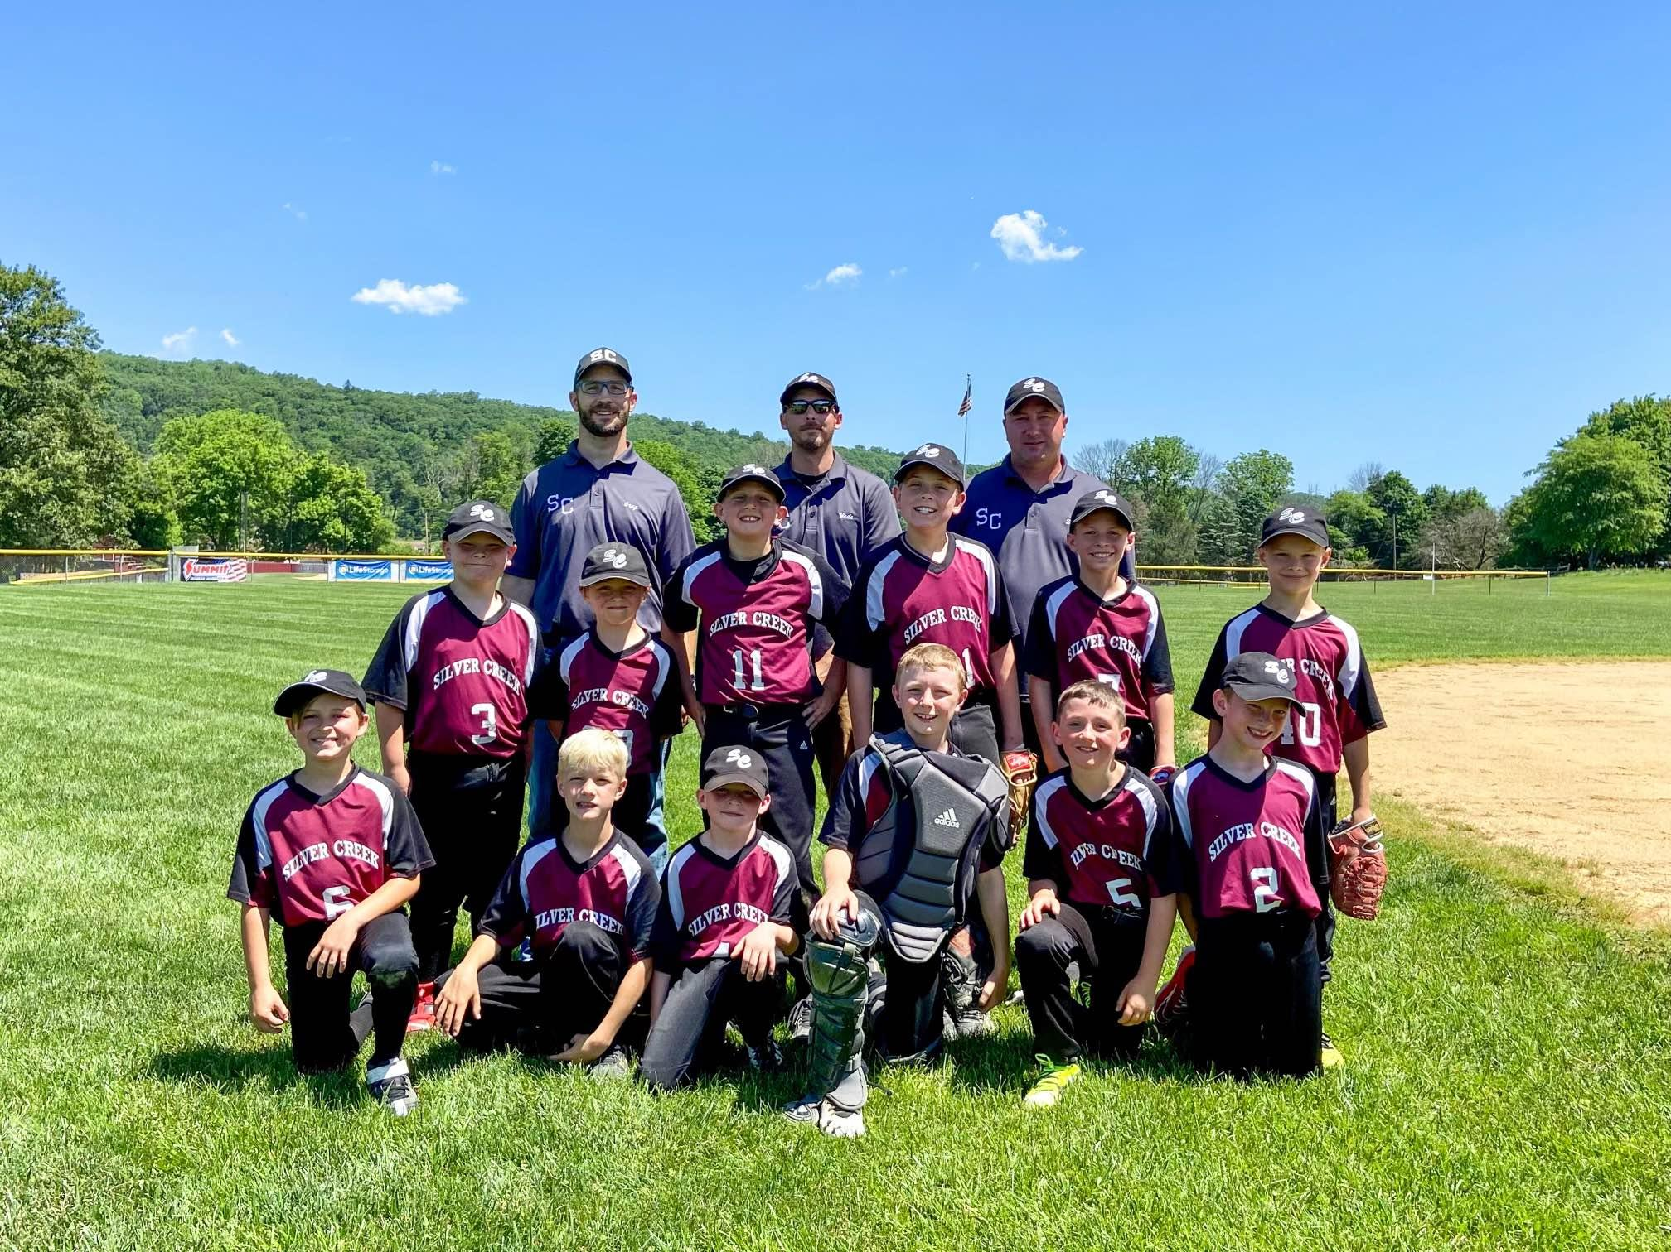
WE LOVE OUR BASEBALL KIDS!

Slide 13
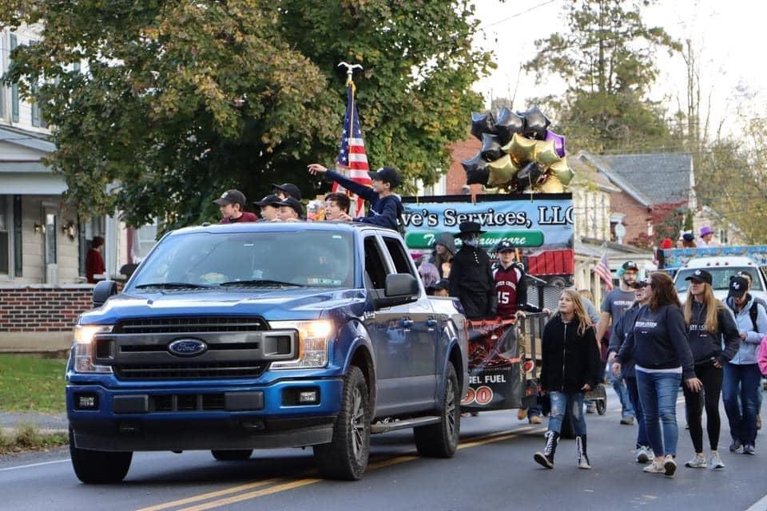
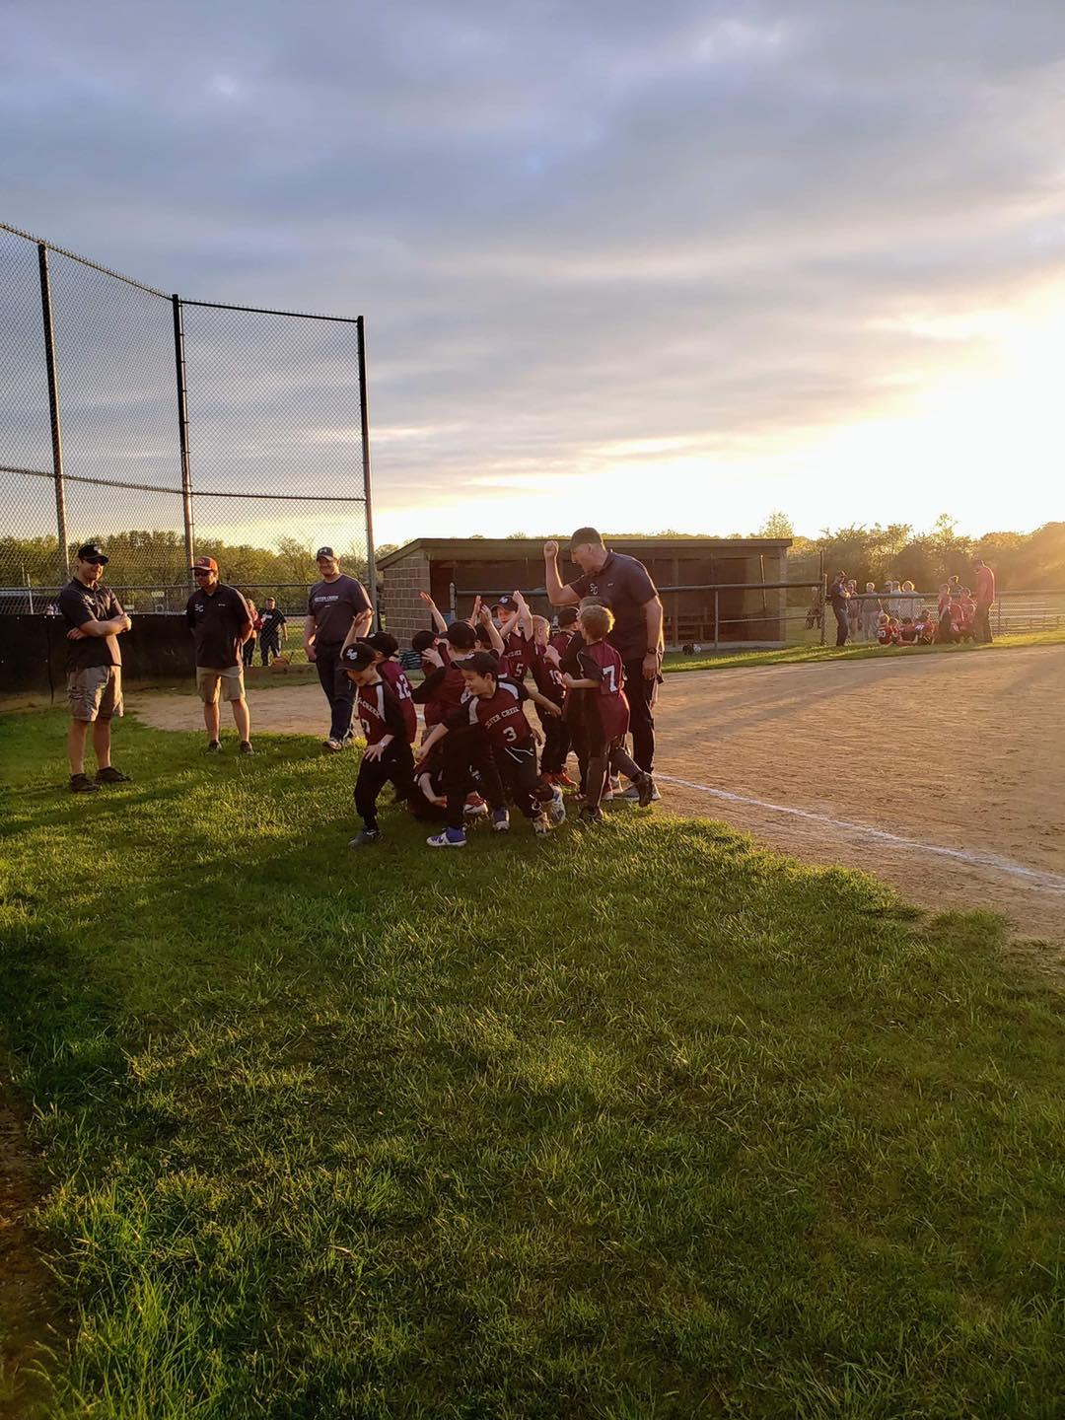
WE LOVE OUR BASEBALL KIDS!

Slide 14
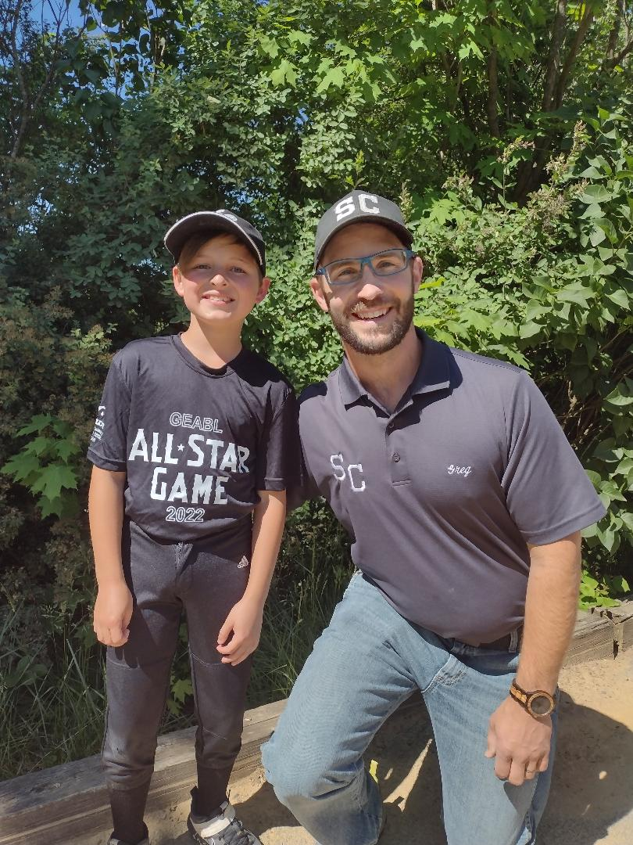
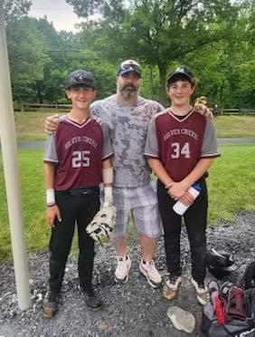
ALL-STAR GAMES SPRING 2022

Slide 15
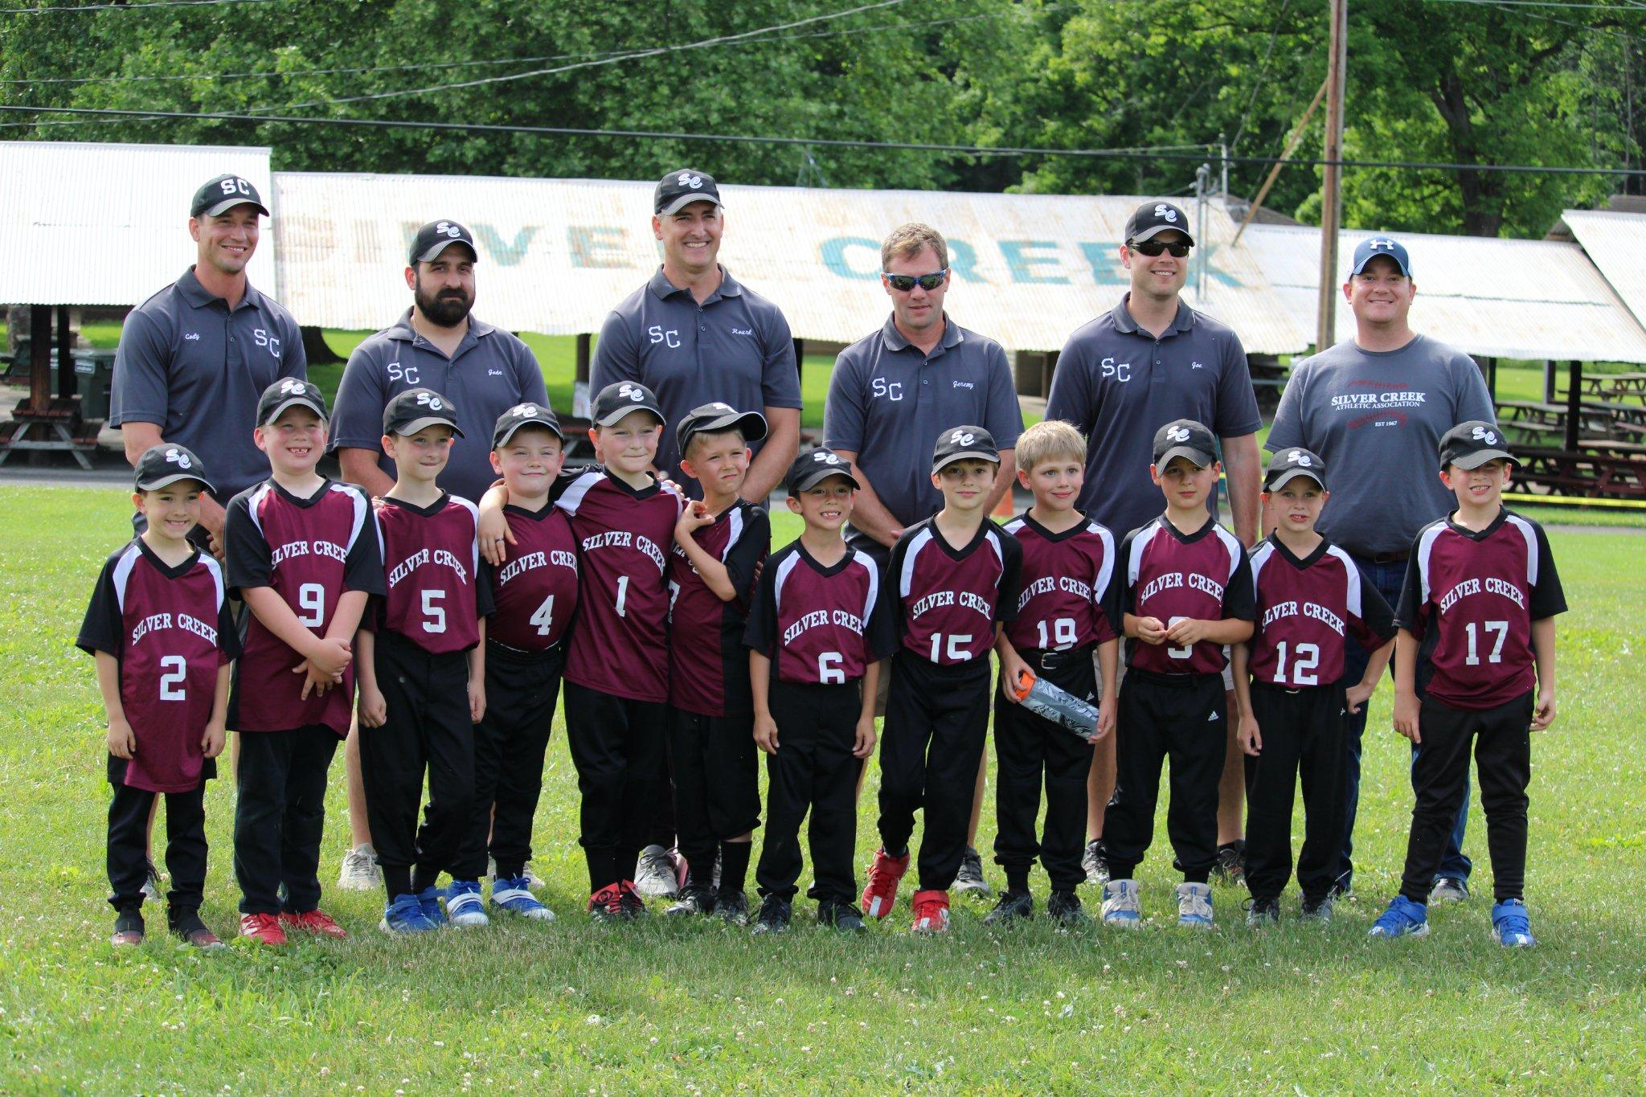
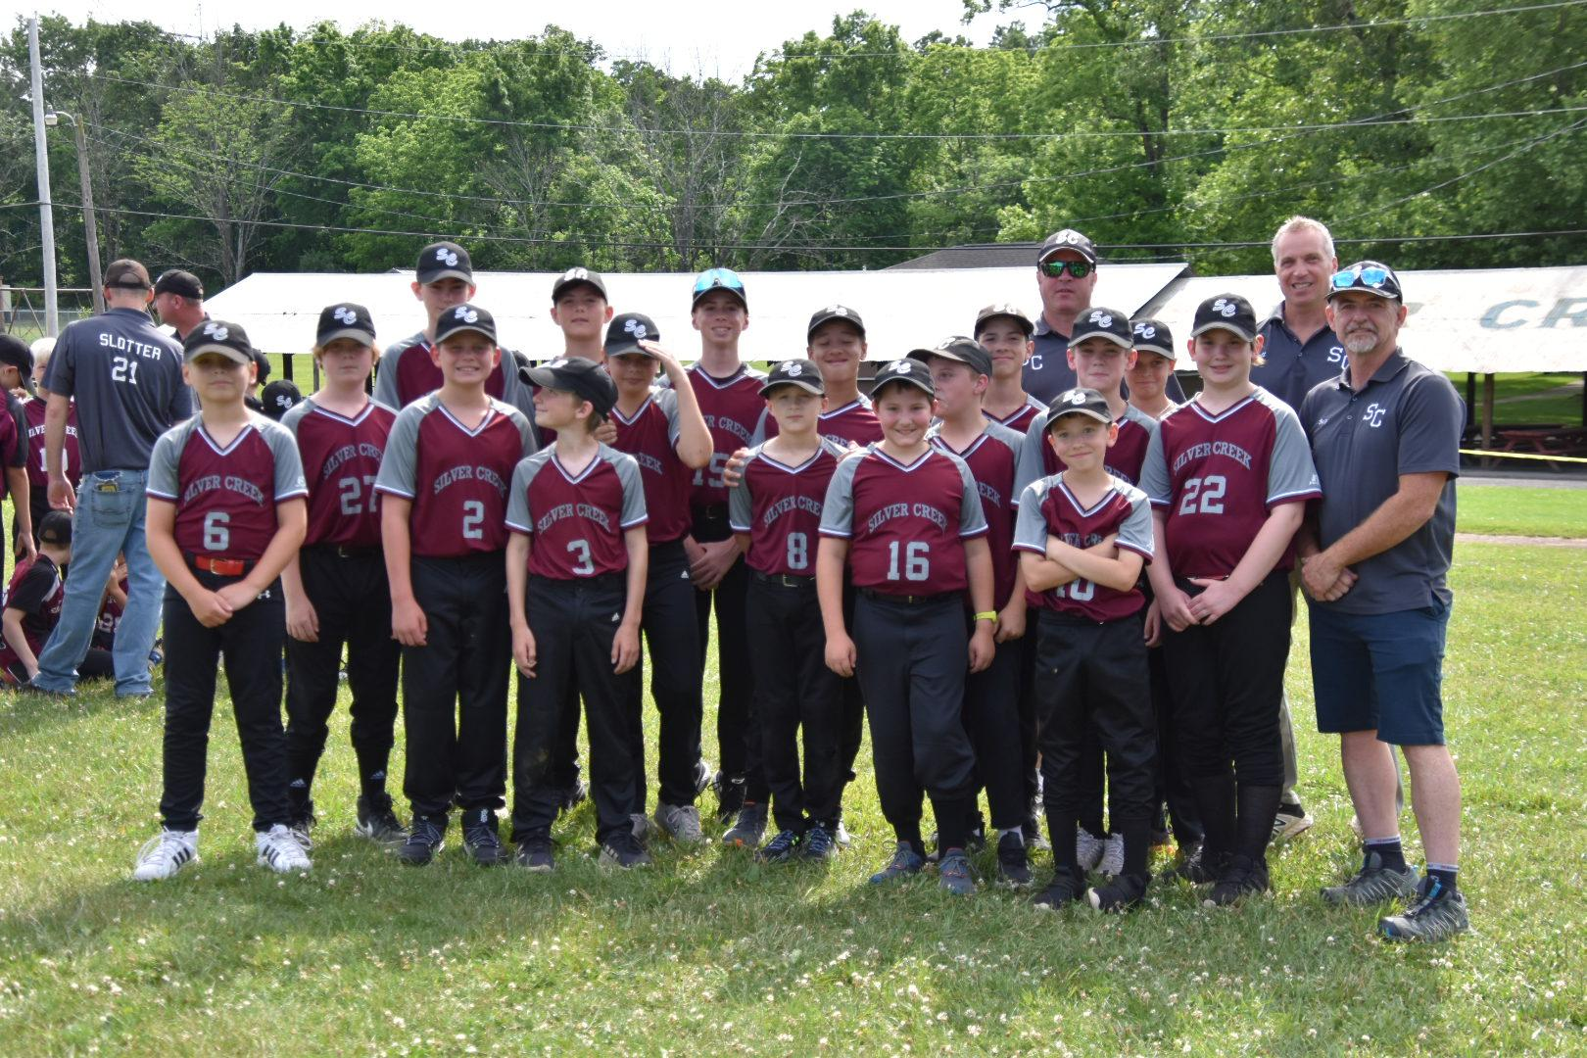
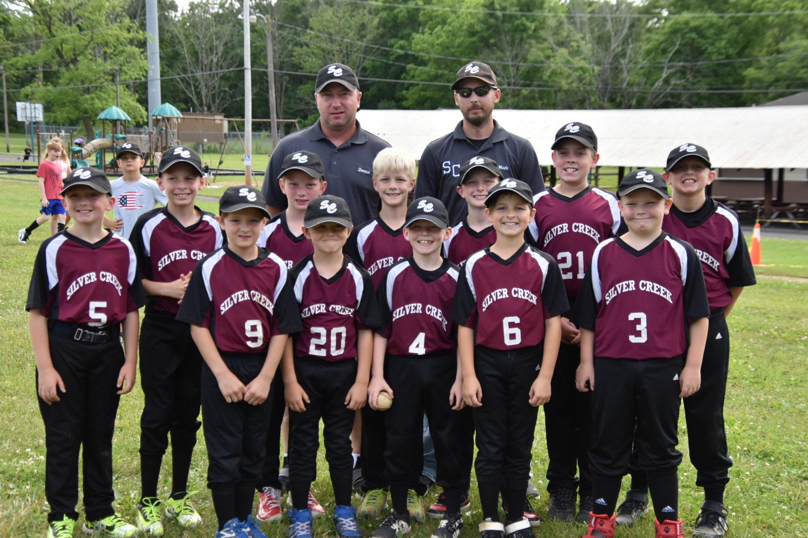
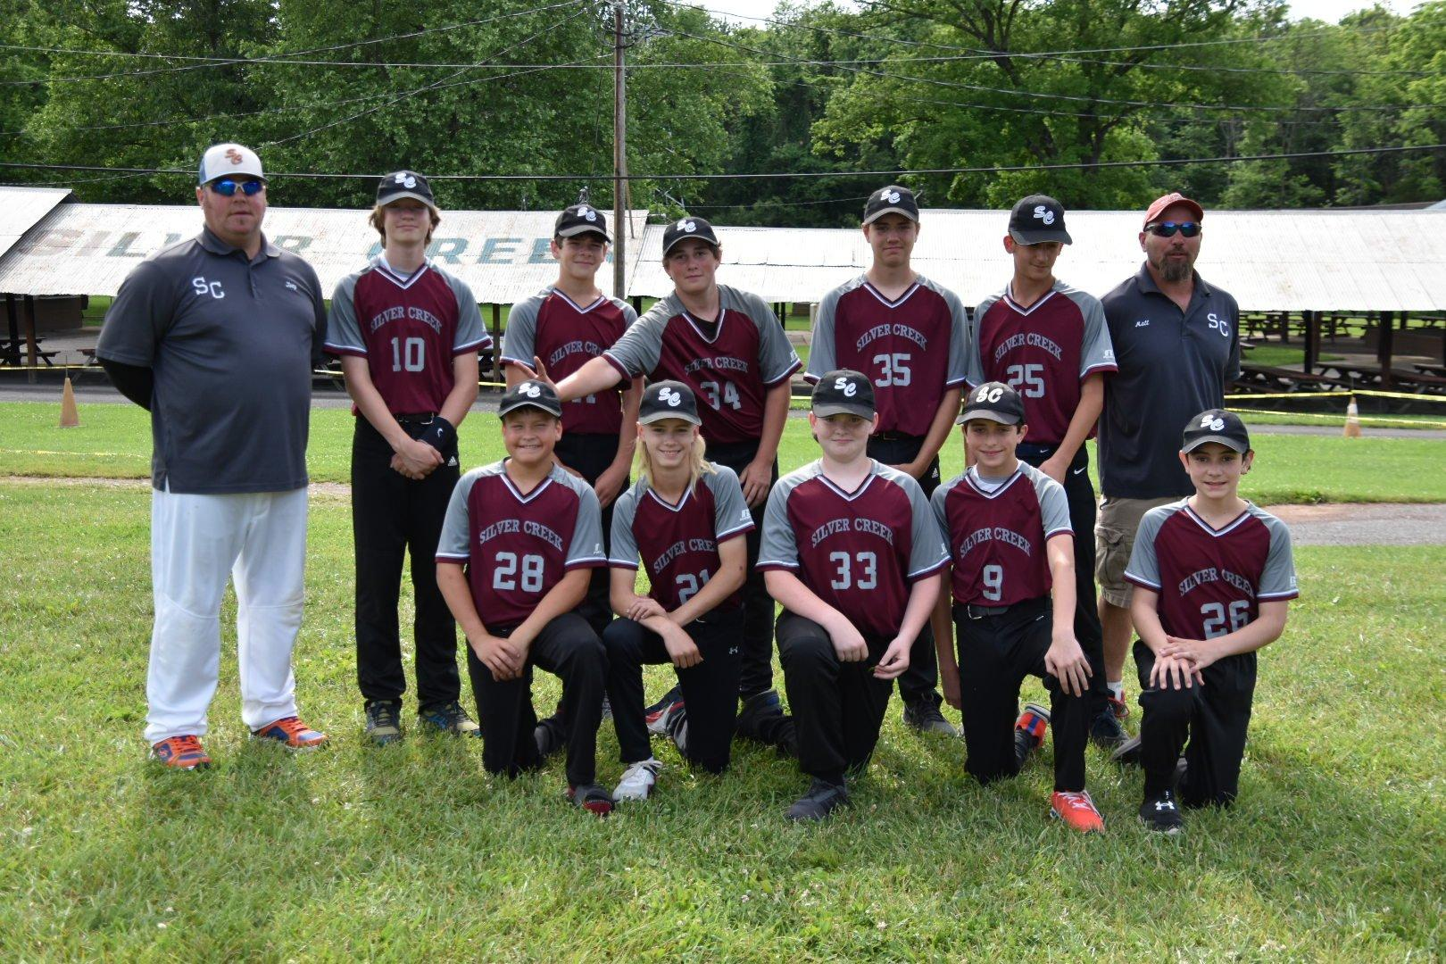

Slide 16
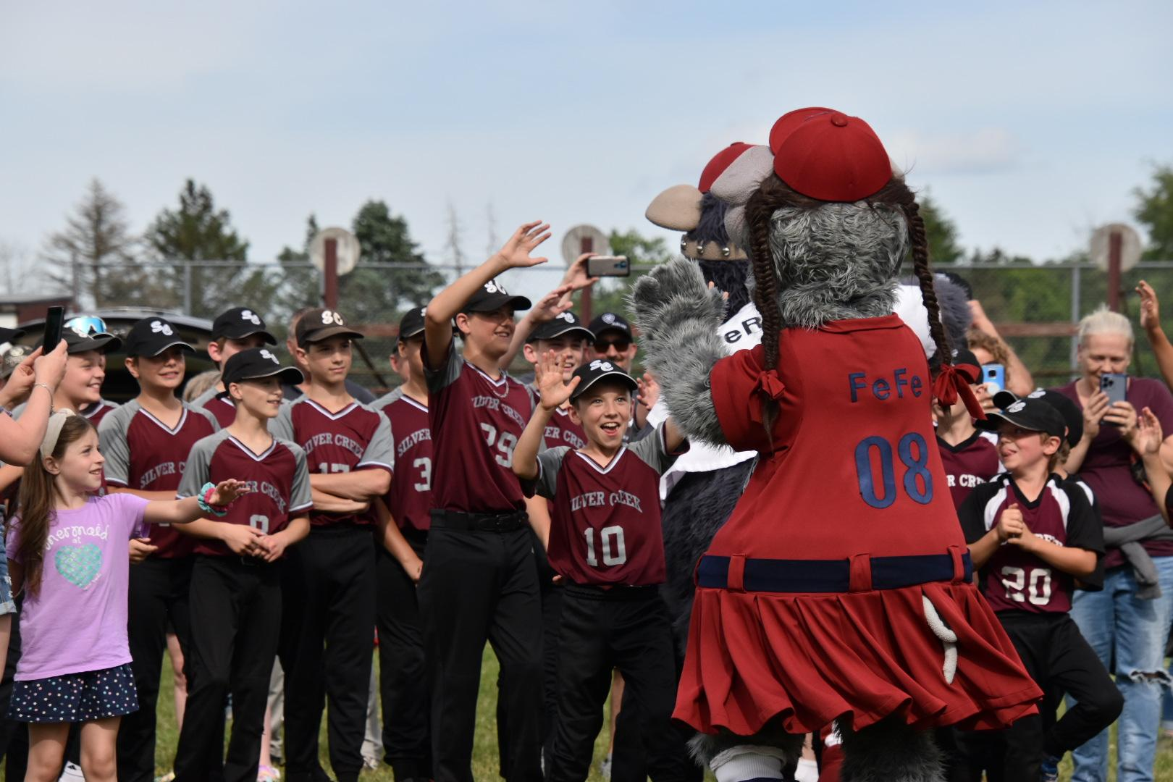
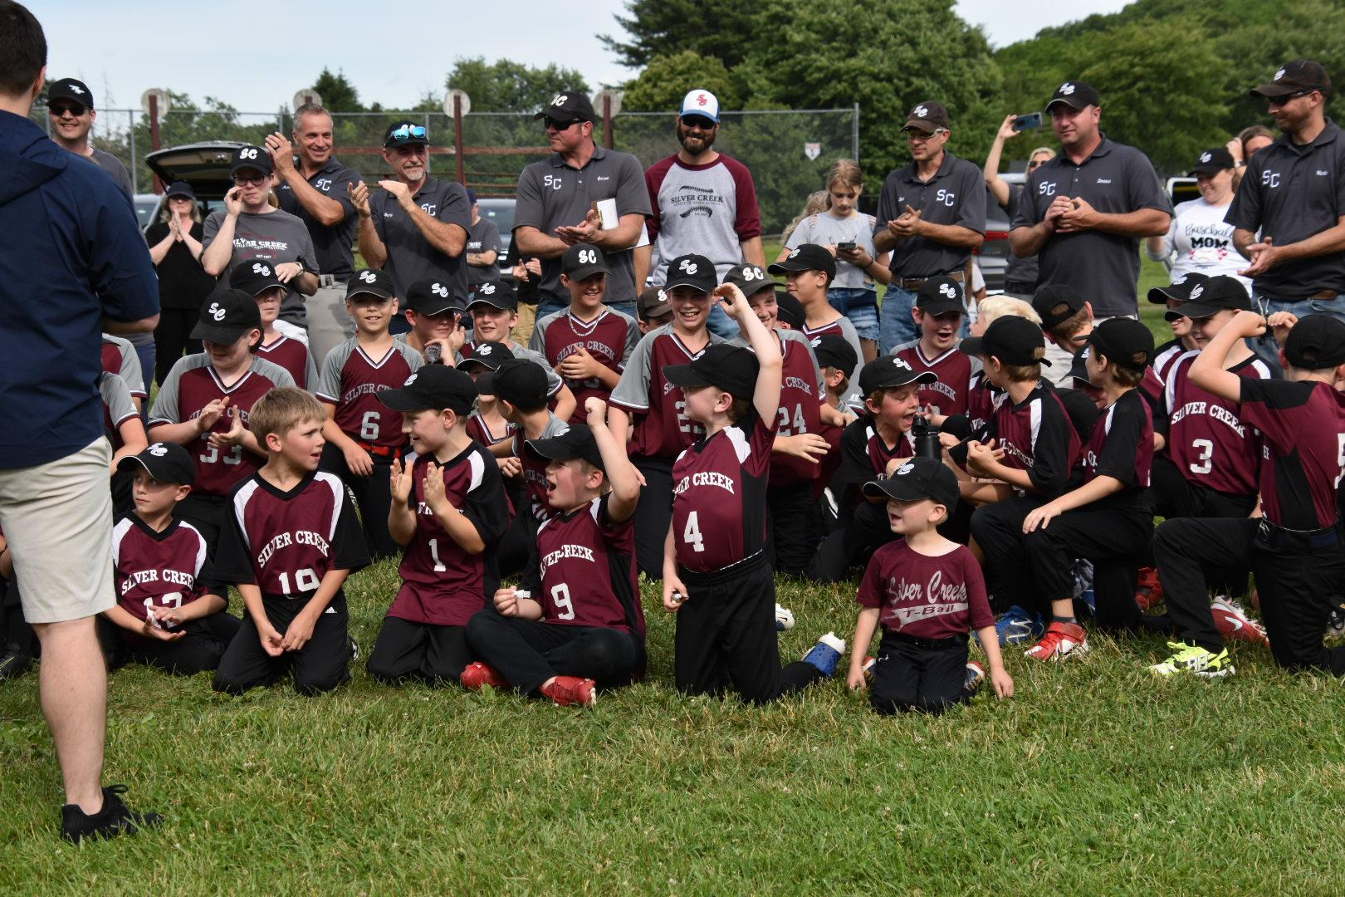
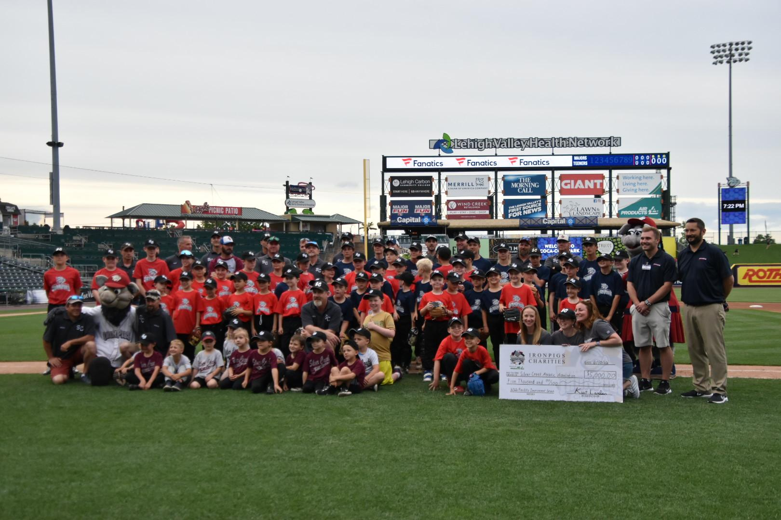
SILVER CREEK’S NIGHT AT THE IRONPIGS!

Slide 17
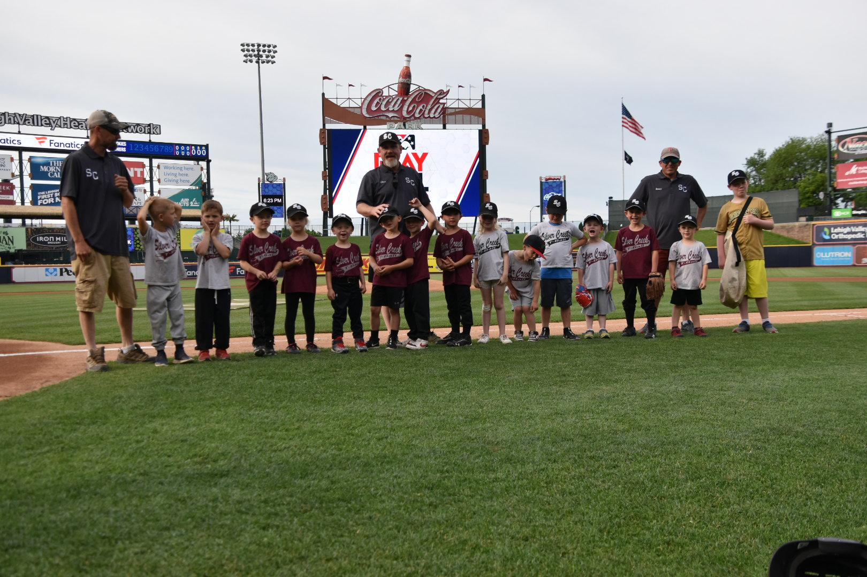
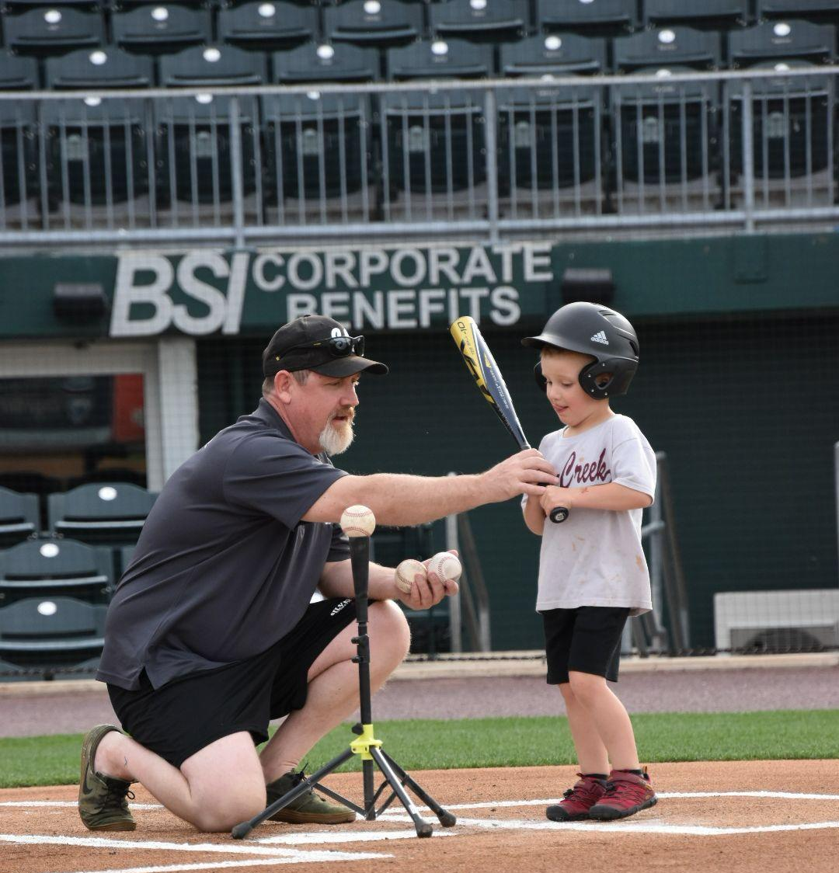
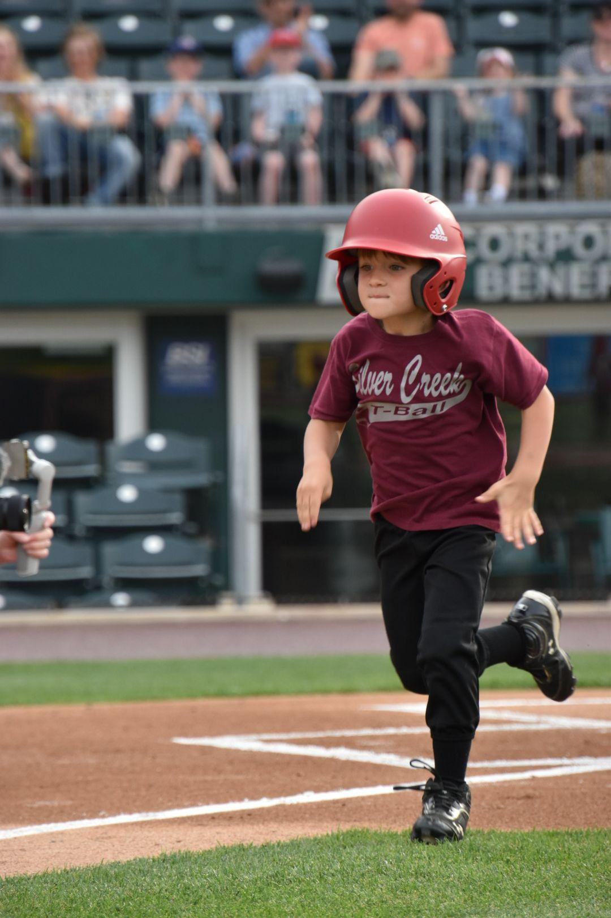
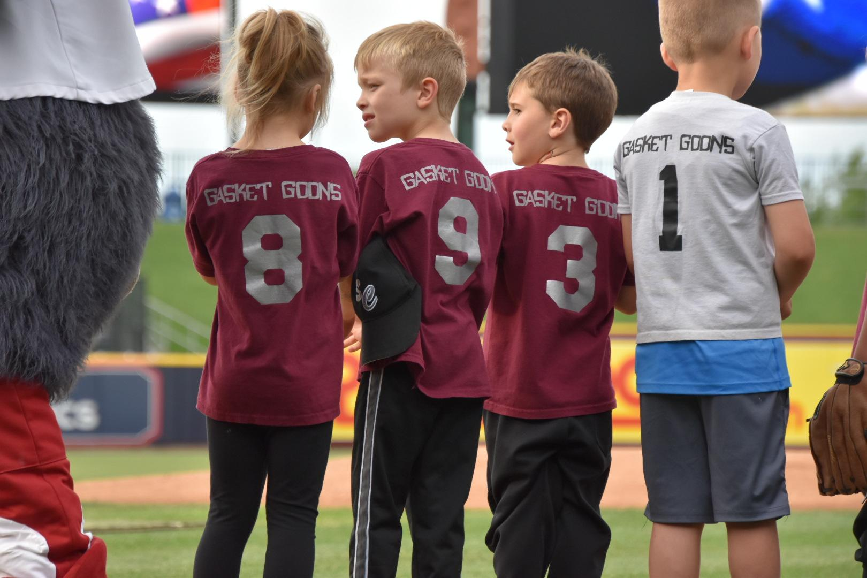
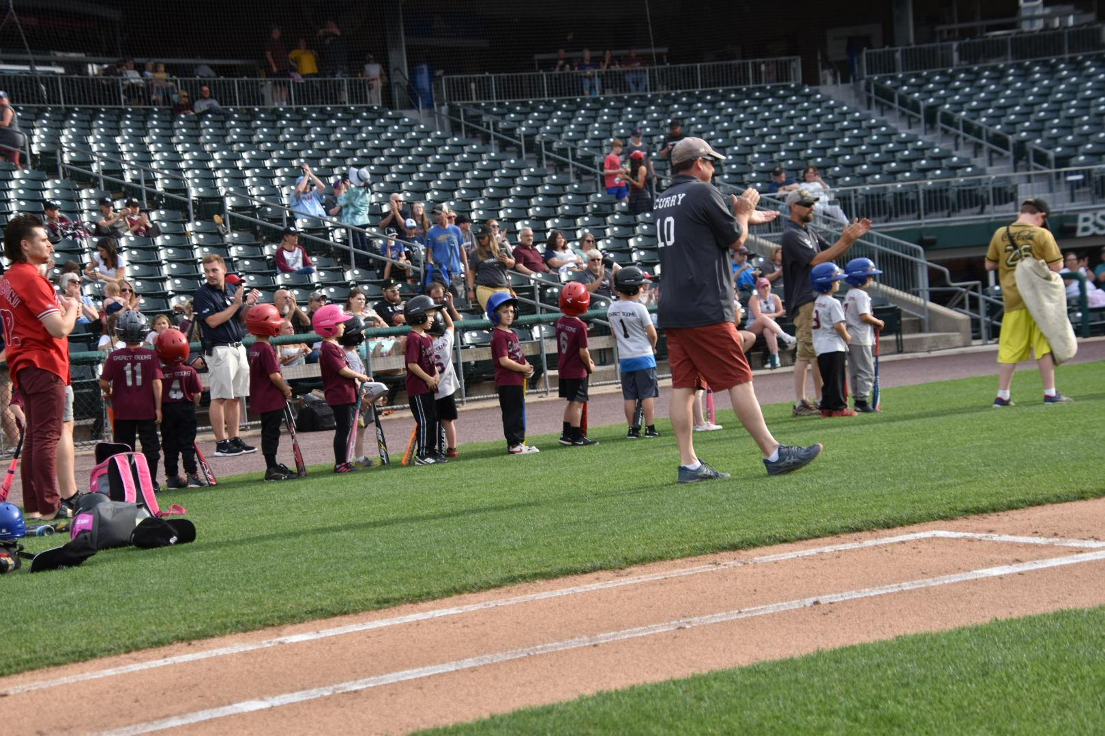
SILVER CREEK’S NIGHT AT THE IRONPIGS!

Slide 18
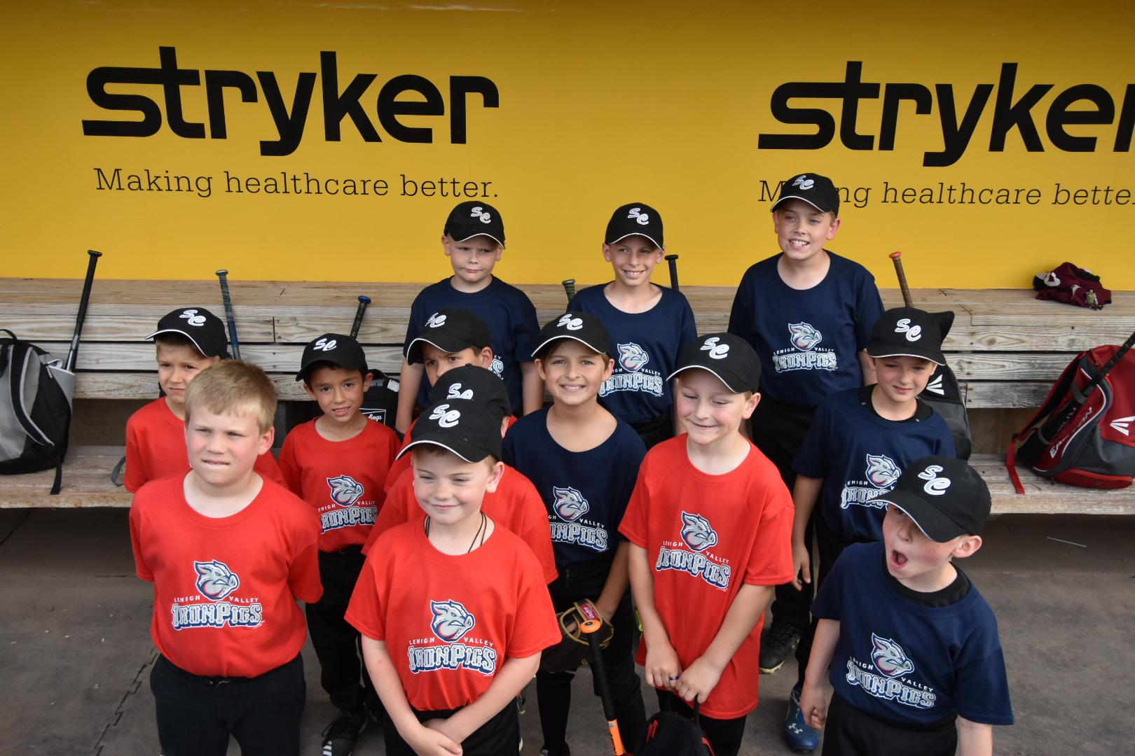
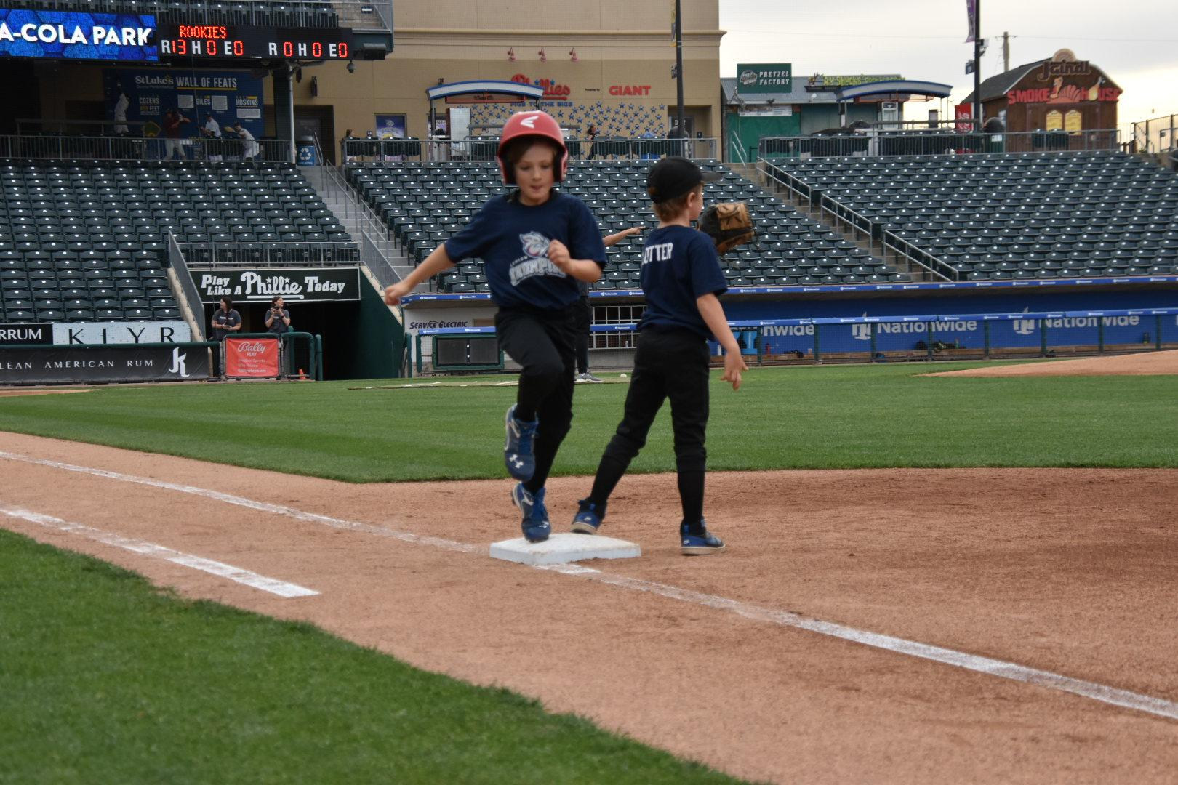
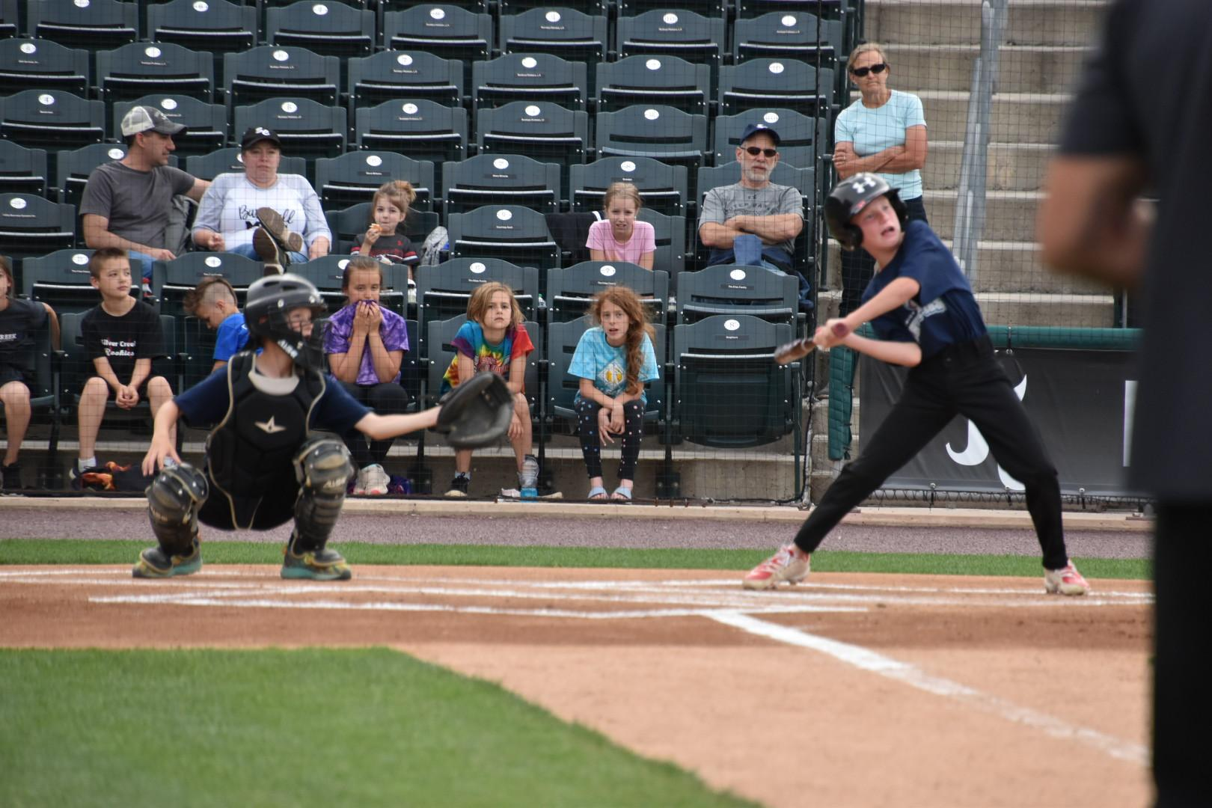

SILVER CREEK’S NIGHT AT THE IRONPIGS!

Slide 19





SILVER CREEK’S NIGHT AT THE IRONPIGS!

Slide 20





THANK YOU COACHES, VOLUNTEERS, AND FAMILIES!

Slide 21



THERE’S JUST SOMETHING SPECIAL ABOUT THIS PLACE

Slide 22




Slide 23

SCAA proudly presents our third annual
cornhole tournament!
Oct. 15, 2022 @ 10am
Register your 2-person team today!

Slide 24






Thank You
SCAA Officers, Trustees and Coaches
610/346-6840
silvercreekaa@gmail.com
www.silvercreekathleticassociation.com

Slide 25
Customize this Template
Template Editing Instructions and Feedback

